Slide 1
Online Reporting System (ORS)
Training Module
Notes:
Welcome to the online training module for the Online Reporting System, also known as ORS. This training module is designed to help you navigate ORS and understand its features.
This training module includes many examples of ORS features. The Online Reporting System User Guide located on the AlohaHSAP.org portal contains additional information about features of ORS that are specific to your state.
Please note that your state’s ORS may be different from the images shown in this presentation.

Slide 2
Objectives
After viewing this presentation, you should understand how to:
Navigate the system
View score reports
Generate and export summary statistics and student results
Search for specific students
View and edit student rosters
Notes:
After viewing this presentation, you should understand how to:
Navigate the system
View score reports
Generate and export summary statistics and student results
Search for specific students
View and edit student rosters

Slide 3
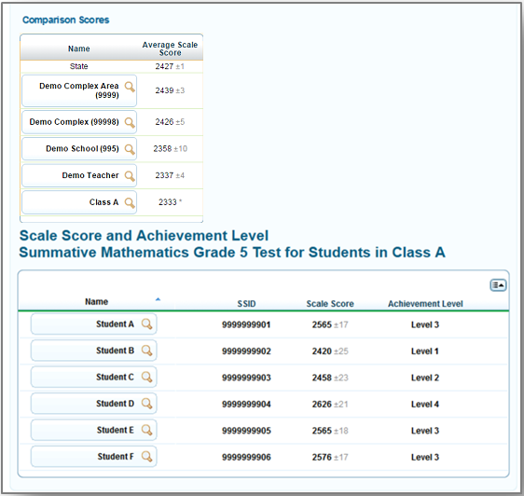
Purpose of the ORS
Provide timely, relevant reports and guide educators to make valid, actionable interpretations of the data
Interactive data
Near real-time reporting (upon completion of scoring the hand-scored responses)
Provide access to data
Downloadable data files for districts, schools, and teachers
Results for multiple assessments in one system
Notes:
The ORS is designed to provide you with assessment data and tools you need to understand the performance of your students. Data presented in the system is interactive, allowing you to apply filters and break down results to better understand student performance. Because ORS can aggregate results in real-time, the system is able to rapidly provide current and reliable reporting information.
Student data can be securely viewed and downloaded for complex areas, schools, and teachers. However, note that students must be registered in the Test Information Distribution Engine, or TIDE, in order for them to be included in the ORS.

Slide 4
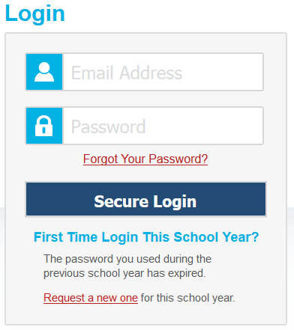
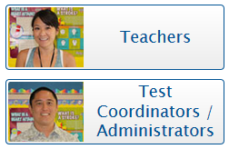
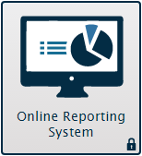
Logging in to ORS
4
Notes:
To log in to ORS, you must have an authorized email address and password, which is the same as the one you use for TIDE and the TA Interface. Contact your School Test Coordinator if you do not have a TIDE account.
The ORS is a secure, role-based system. Your access to reports and data in the system depends upon your user role and your complex area and school associations.
To log in to ORS, go to the HSAP portal at alohahsap.org. Click the appropriate assessment card, then the appropriates user role. On the next page, click the ORS system card. Enter your username and password, and then click Secure Login.

Slide 5
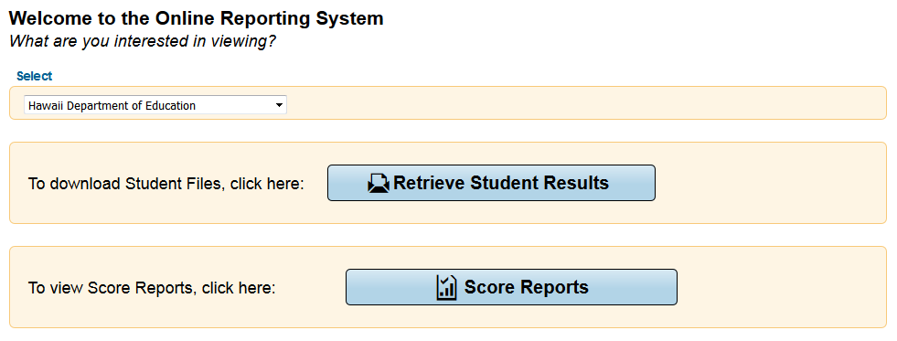
ORS Interface: Welcome Page
CAUTION: Any student information downloaded is confidential and must be kept in a secure location or shredded after use.
Notes:
The Welcome page appears when you first log in to the ORS and asks you to select the type of report you want to view. Note that you can navigate to a different report at any time within ORS.
Retrieve Student Results allows you to download student data for a complex area, school, teacher, or roster, depending on your user role. The data includes students’ personal information and their performance on the selected test and administration.
Score Reports provide test score data. You can compare score data between individual students and the school, complex, complex area, or overall state average scores. Information on strengths and weaknesses in a specified field is also available by claim.
CAUTION: Any student information downloaded is confidential and must be kept in a secure location or shredded after use. Files stored on a desktop must be password-protected; files transmitted electronically with student information must be sent via encrypted email and files must be password protected with the password sent in a separate email.

Slide 6
ORS Interface: Global Tools
Notes:
The ORS banner that is displayed near the top of each page consists of buttons or “Global Tools” for accessing the different reports and performing different tasks.
The Score Reports button takes you to the Home Page Dashboard that provides overall score data for your complex area, school, or students, depending on your user role.
The Reports & Files button provides access to test summary statistics and the Retrieve Student Results page where you can download large files of student results.
Inbox takes you to the Inbox section of the Retrieve Student Results page that lists the student data files you have requested.
Search Students lets you search for student information by using the student’s name or SSID number.
Add Roster allows you to create custom rosters of your students for data analysis.
View/Edit Rosters allows you to view existing rosters and add or remove students from them as desired.
In addition, the banner consists of the following Global Tools:
The Help button is where users may find useful information and step-by-step instructions for performing tasks in ORS.
Print provides options to print the data displayed on the page.
Export exports the data displayed on the page as an Excel file.
Definitions provides definitions for terms specific to the report you are viewing. This tool only appears on some pages.

Slide 7
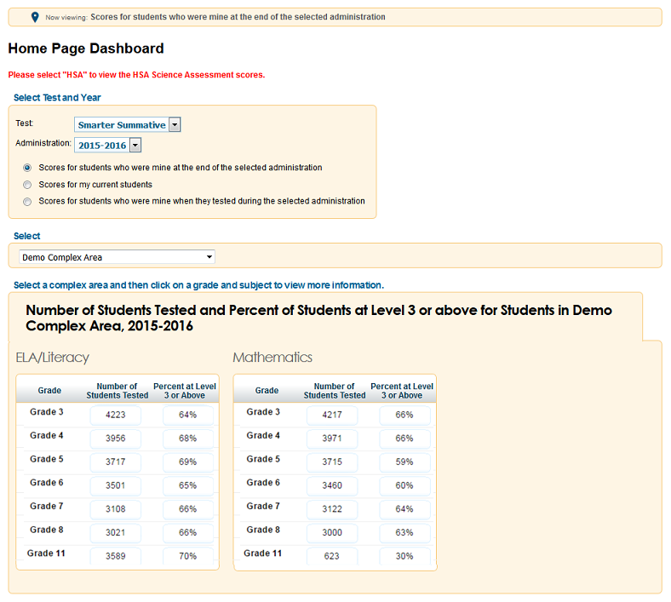
Home Page Dashboard
Notes:
When you click Score Reports on the Welcome Page or from the banner, the Home Page Dashboard page appears.
This page provides data about your students, the number of students tested, and the percentage proficient for the selected test and administration. Complex area personnel see complex area summaries, school personnel see school summaries, and teachers see summaries of their students.

Slide 8
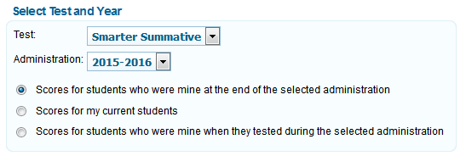
Home Page Dashboard: Select Test and Administration
You can select the test and administration for which you want to view score data.
Notes:
From the Home Page Dashboard page, you can select the test and administration for which you want to view score data. You can also specify the students whose data you wish to view using the available radio buttons.
This feature is particularly helpful for school personnel who want to see how students currently assigned to the user’s class roster performed in previous grades, even if students were enrolled in different schools during those previous administrations.
If you currently have a student who did not test in the selected test and administration, no data will be displayed for that student. An example may be students who moved to your school from out of state.

Slide 9
Home Page Dashboard: Defining the Student Population
Scores for students who were mine at the end of the selected administration | Scores for my current students | Scores for students who were mine when they tested during the selected administration
Allows you to see score data for those students who tested in the selected test and administration and remained associated with your roster, school, or complex area through the end of the administration. | Allows you to view score data for students assigned to your current rosters, even if they were previously enrolled in a different school. | Allows you to see score data for those students who were associated with your roster, school, or complex area when they were tested in the selected test and administration
Notes:
Scores for students who were mine at the end of the selected administration allows you to see score data for those students who tested in the selected test and administration and were associated with your roster, school, or complex area at the end of the selected test and administration.
Scores for my current students allows you to view score data for students assigned to your current rosters, even if they were previously enrolled in a different school. This view enables you to see your current students’ previous strengths and weaknesses before they begin testing this year.
Scores for students who were mine when they tested during the selected administration allows you to see score data for those students who were associated with your roster, school, or complex area when they were tested in the selected test and administration.
On the next few slides, we will illustrate an example of how to use the three radio buttons.

Slide 10
Home Page Dashboard: Defining the Student Population
A
B
Notes:
Imagine that two of your students, Student A and Student B, took a Summative 2015-2016 test.

Slide 11
Home Page Dashboard: Defining the Student Population
C
A
B
Notes:
Immediately after testing, Student B moved to a different district.
Then, after the Summative 2015-2016 administration ended, a new student, named Student C, joined your class after taking the test in a different school.

Slide 12
Home Page Dashboard: Defining the Student Population
C
A
B
Notes:
Selecting the first radio button will include Student A’s score and exclude scores for Students B and C from reports.

Slide 13
Home Page Dashboard: Defining the Student Population
C
A
B
Notes:
Selecting the second radio button will also exclude Student B’s score, but it will include Student C, who is currently associated with you.

Slide 14
Home Page Dashboard: Defining the Student Population
C
A
B
Notes:
Selecting the third radio button will include scores for Students A and B, and exclude Student C’s scores from the report.

Slide 15
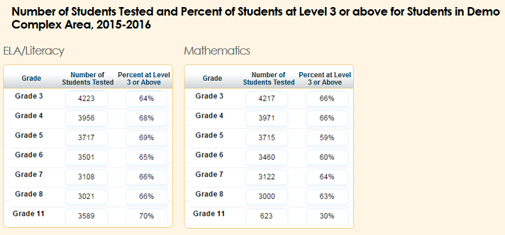
Home Page Dashboard: Report Tables
Notes:
After defining which students you wish to view, look toward the tables near the bottom of the Home Page Dashboard page. These tables display aggregate data for each subject.
Grade displays the grade to which the score data belongs.
Number of Students Tested displays the number of students to date who have completed and submitted their tests for scoring.
Percent Proficient displays the percentage of students to date who have scored proficient on each test.
To access score reports for a particular subject and grade-based test, click a cell for the selected grade and subject. You will only see the tests administered by the selected complex area or school. When you click a cell, a Subject Detail Report will load for the corresponding grade and subject.

Slide 16
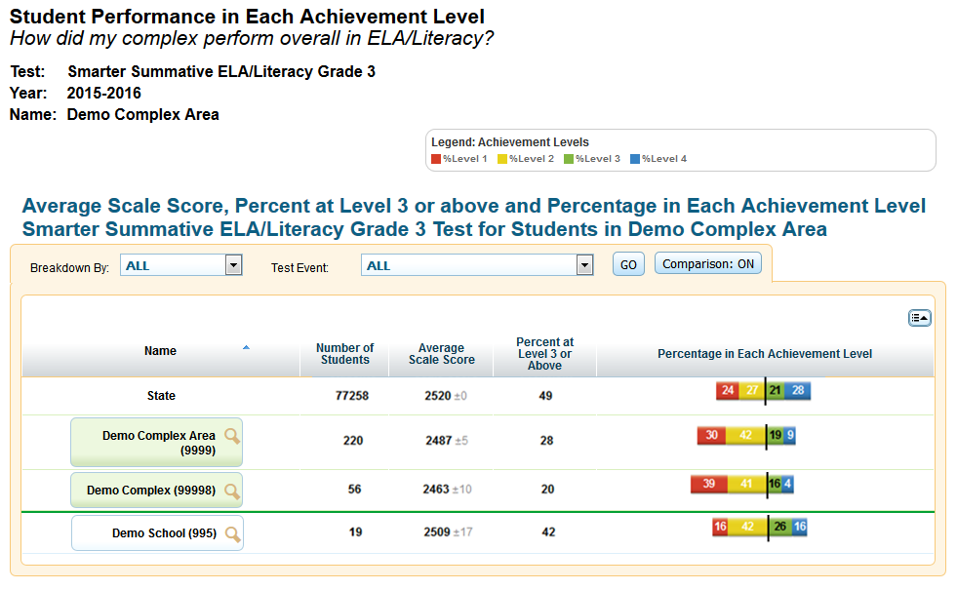
Subject Detail Report
Notes:
This example shows the information a complex user will see on the Subject Detail Report. It shows the list of schools in the complex area and their aggregate score data.
You can sort the data, show or hide columns, disaggregate data by subgroups and/or test events, and show or hide comparison data.
To disaggregate the score data by a specific demographic subgroup category, from the Breakdown By drop-down list, select a group and click Go. The report will expand to display the data for each subgroup. For example, you can select Gender to see score data for All students, Female students, and Male students.
To disaggregate the score data by a specific student accommodation or support, from the Test Event drop-down list, select an accommodation and click Go. The report will expand to display the data for each subgroup. If students are able to have different accommodations for different parts of the same test, these students can either be included in a separate category called “Multiple” or counted under both accommodation values.

Slide 17
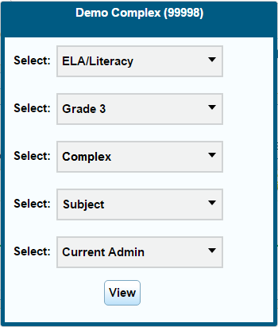
Subject Detail Report
Notes:
To view more information about a student, roster, teacher, school, or complex area, click the magnifying glass icon that appears next to its name. An exploration menu will appear with the name of the entity you clicked in the title. The exploration menu is the preferred method for moving between reports and deciding which type of data you would like to view.

Slide 18
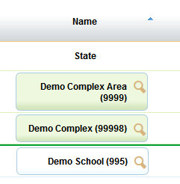
Score Report Navigation: General Approach
SUBJECT
GRADE
Notes:
The exploration menu’s first two drop-down lists display the subject and grade of the report that you are viewing. You can use these menus to switch to a different subject within the same assessment or to a different grade without returning to the Home Page Dashboard.

Slide 19
Score Report Navigation: General Approach
WHO
WHAT
WHEN
Notes:
The other three drop-down lists determine the type of report that will load when you click the View button.
To help you quickly locate the score data you need, these three drop-down lists allow you to ask three different questions: Who, What, and When. Your answers to these questions will direct ORS to provide data from that perspective.

Slide 20
Score Report Navigation: General Approach
Complex Area
School
Teacher
Roster
Student
Complex
Who
What
Subject
Claims
Targets
When
Current Administration
Trend
Notes:
This slide displays some typical examples of the selections you can make in the Who, What, and When drop-down lists. Note that the particular selections you see will depend on your user role, the report you are viewing, and which entity’s magnifying glass you clicked. When you see “N/A” or no options in a drop-down list, that means you cannot navigate any further in that drop-down list.
The Who drop-down list determines who will be listed in the report, including all students associated with the complex area, school, teacher, or roster that you clicked.
The What drop-down list lets you explore the data by claims and targets within the selected subject or content area. This drop-down list includes options to view performance data by subject, claims, and targets. You may see different options in this drop-down list, depending on your state’s ORS and the test you have selected.
The When drop-down list allows you to explore score data across multiple administrations of the same test to the same group of students. It allows you to see the data either as a snapshot of performance in the current test window, or as a historical trend. Generally, this option is only available in states that have score data from multiple test administrations available in ORS.
For more information on using the exploration menu to navigate between score reports, consult the Online Reporting System User Guide.

Slide 21
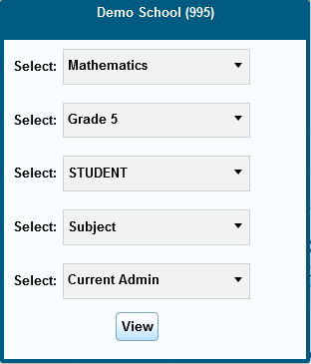
Student Listing Report
Notes:
Using the exploration menu, you can view reports at different levels depending on your user role—complex areas, schools, teachers, rosters, and students. This is a sample student listing report showing student performance in each achievement level. You can access the student listing report by clicking the magnifying glass next to a school, teacher, or roster, and then selecting Student in the exploration menu’s “Who” drop-down list.

Slide 22
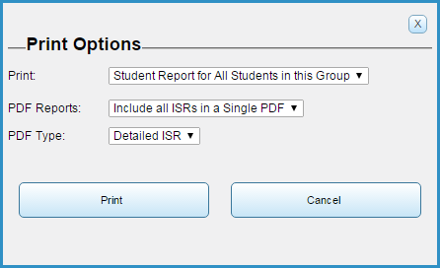
Student Listing Report: Printing
Notes:
On most pages in ORS, using the Print tool in the ORS Banner simply prints the currently displayed information. However, printing from the student listing report works a bit differently.
When using the Print tool on the student listing report, a print pop-up window will appear, giving you the option to print just the currently displayed page, or to print a separate Individual Student Report (or ISR) for each student in the list. You can choose to include all of the ISRs in a single PDF, or you can download each ISR in a separate PDF, with the batch of PDFs contained in a ZIP file.
If detailed ISRs are available for the assessment you are viewing, you can choose whether to print simple or detailed ISRs. Simple ISRs include less information, but are specifically designed to fit on a single sheet of paper.
When the PDF file or ZIP file is ready, you can download your file by clicking My Inbox in the ORS banner.

Slide 23
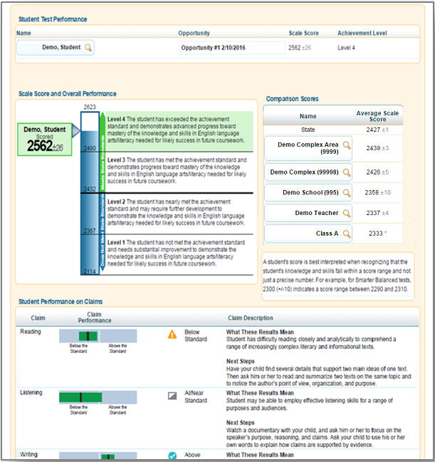
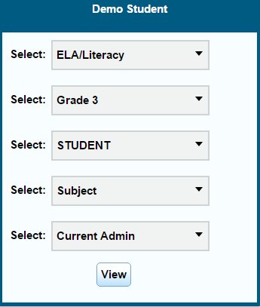
Individual Student Report
Notes:
An Individual Student Report presents a graphic representation of proficiency, along with a parent-friendly description of what the different proficiency levels mean. It includes more detailed diagnostic information and comparison scores for the class, teacher, school, complex area, and state. It also includes student performance on each claim along with a description of each claim. The report may additionally include a trend graph that visually depicts student performance over time.
You can access a student’s ISR by clicking the magnifying glass next to any student’s name, and selecting Student in the exploration menu’s “Who” drop-down list.
If a student has taken multiple opportunities of the test, such as the HSA Science Assessment, all of the test opportunities will be listed on the report, and you can toggle between the opportunities by clicking the opportunity number.

Slide 24
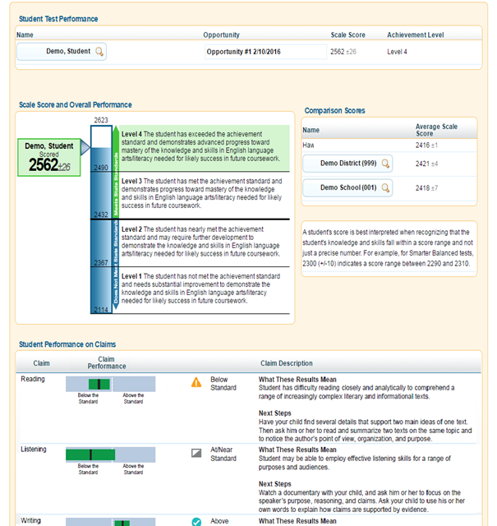
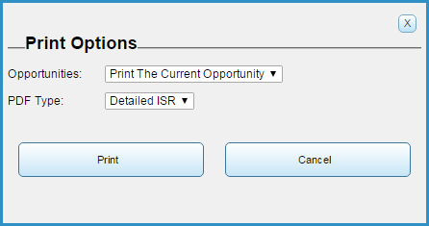
Individual Student Report: Printing
Notes:
Using the Print tool, you can generate a PDF report of the student’s score report. You can choose to print the current opportunity, the opportunity where the student scored the highest, or all the opportunities taken by the student.
You may also choose to print a detailed ISR or a simple ISR.

Slide 25
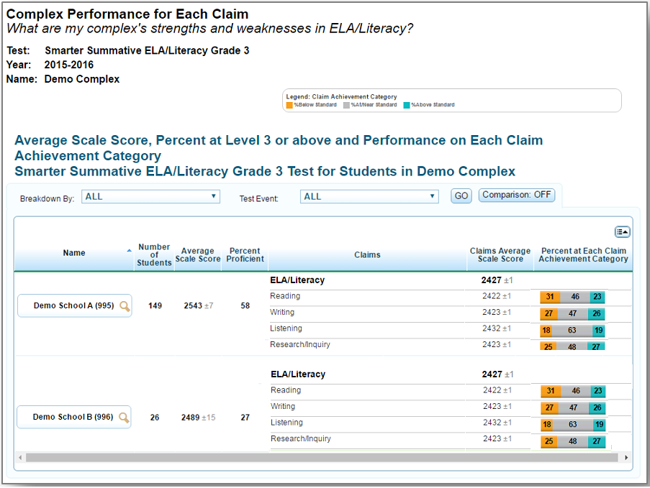
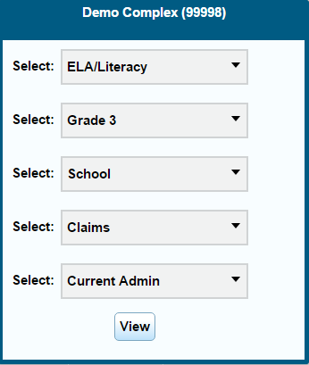
Claim Detail Report
Notes:
You can view more content detail for a group of students by clicking the magnifying glass next to a school, teacher, or roster, and then selecting Claim or Reporting Category in the exploration menu’s “What” drop-down list. This is a sample complex area Claim Detail Report, which includes a scale score for each claim in the selected subject.

Slide 26
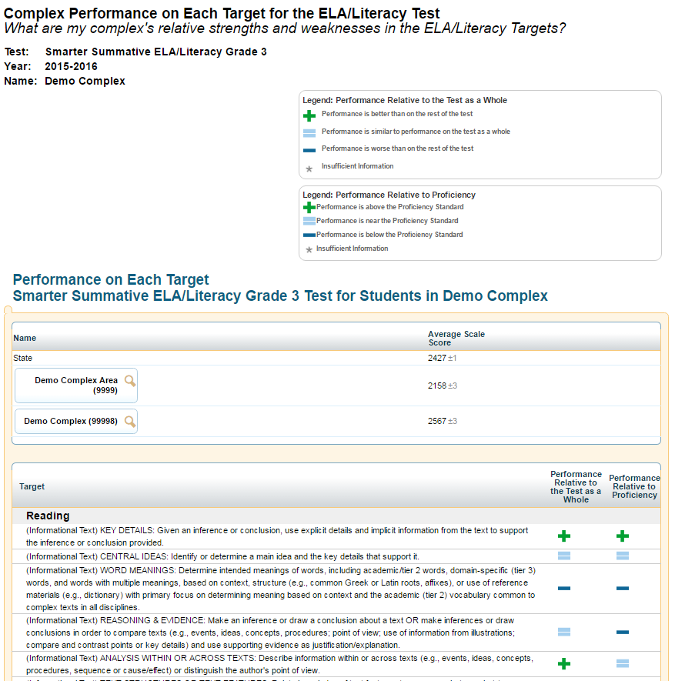
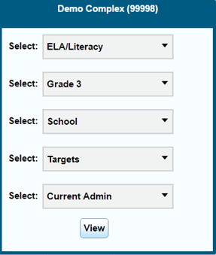
Target Detail Report
Notes:
For assessments that have targets or content standards, you can view an even more specific content detail by selecting Target, Benchmark, or Content Standard in the exploration menu’s “What” drop-down list. This is a sample complex area Target Detail Report, which shows how a group of students performed on each target compared to the test as a whole, and compared to the proficiency standard.

Slide 27
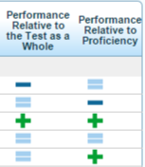
Target Legend: Performance Relative to the Test as a Whole
Benchmark Level |  | Description
 | Better than performance on the test as a whole | This target is a relative strength. The group of students performed better on items from this target than they did on the rest of the test as a whole.
 | Similar to performance on the test as a whole | This target is neither a relative strength nor a relative weakness. The group of students performed about as well on items from this target as they did on the rest of the test as a whole.
 | Worse than performance on the test as a whole | This target is a relative weakness. The group of students did not perform as well on items from this target as they did on the rest of the test as a whole.
 | Insufficient Information | Not enough information is available to determine whether this target is a relative strength or weakness.
Notes:
This table explains the meaning of each icon in column named Performance Relative to the Test as a Whole.
Better than performance on the test as a whole means this target is a relative strength. The group of students performed better on items from this target than they did on the rest of the test as a whole.
Similar to performance on the test as a whole means this target is neither a relative strength nor a relative weakness. The group of students performed about as well on items from this target as they did on the rest of the test as a whole.
Worse than performance on the test as a whole means this target is a relative weakness. The group of students did not perform as well on items from this target as they did on the rest of the test as a whole.
Insufficient Information means not enough information is available to determine whether this target is a relative strength or weakness. This could be due to too few items or too few students available to create a report.

Slide 28
Target Legend: Performance Relative to Proficiency
Benchmark Level |  | Description
 | Performance is above the Proficiency Standard | The target performance is above the proficiency standard. The group of students performed above the proficiency standard on this target.
 | Performance is near the Proficiency Standard | The target performance is near the proficiency standard. The group of students performed near the proficiency standard on this target.
 | Performance is below the Proficiency Standard | The target performance is below the proficiency standard. The group of students performed below the proficiency standard on this target.
 | Insufficient Information | Not enough information is available to determine whether the performance on this target is above, near, or below the proficiency standard.
Notes:
This table explains the meaning of each icon in column named Performance Relative to Proficiency.
Performance is above the Proficiency Standard means the target performance is above the proficiency standard. The group of students performed above the proficiency standard on this target.
Performance is near the Proficiency Standard means the target performance is near the proficiency standard. The group of students performed near the proficiency standard on this target.
Performance is below the Proficiency Standard means the target performance is below the proficiency standard. The group of students performed below the proficiency standard on this target.
Insufficient Information means not enough information is available to determine whether the performance on this target is above, near, or below the proficiency standard.

Slide 29
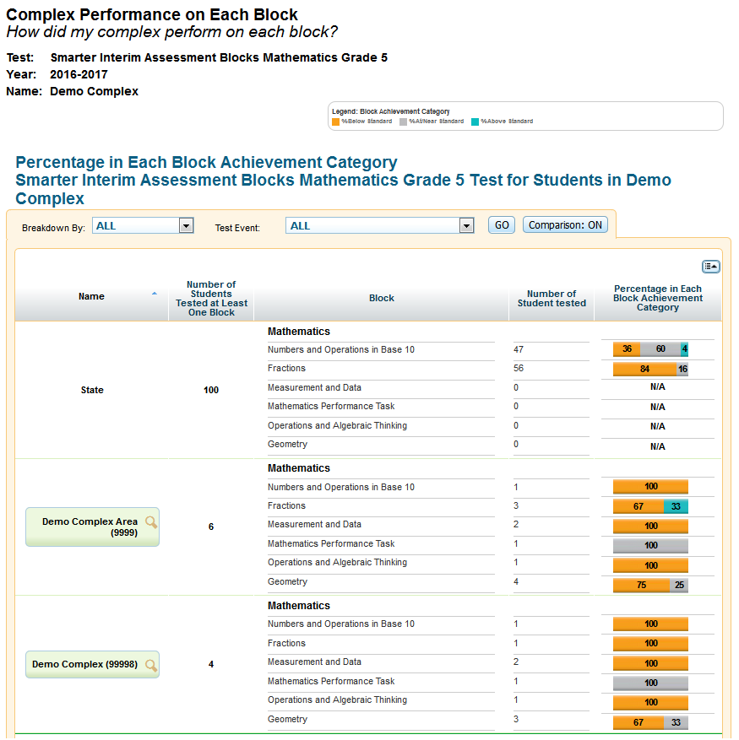
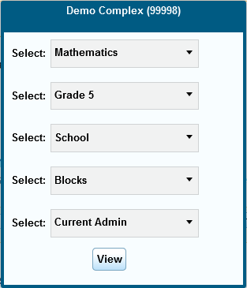
Reporting by Block: Interim Assessment Blocks (IAB)
Notes:
When viewing score reports for Interim Assessment Blocks, you may view how the state, complex area, school, teacher, and classes performed on each of the blocks by selecting Blocks in the exploration menu’s “What” drop-down list and then clicking View. This report shows the number of students tested by block and the percentage in each block performance level.

Slide 30
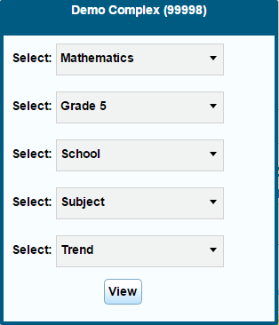
Trend Reports
Notes:
You can explore student performance over time by clicking the magnifying glass next to a school, teacher, roster, or student; and then selecting Trend in the exploration menu’s “When” drop-down list. This is a sample complex area trend report. In addition to displaying the average scale score and achievement level, you can now choose to view the percentage of students proficient in a roster, school, or complex area by selecting Percent Proficient in the Trend Data drop-down list and then clicking Go.
You can use the “Who,” “What,” and “When” drop-down lists together to show different kinds of data in a graph across time. The trend report is set to plot summative and interim administrations on the graph by default. However, you may choose to plot only the currently selected test by choosing Selected Test from the Display drop-down list, and then clicking Go.

Slide 31
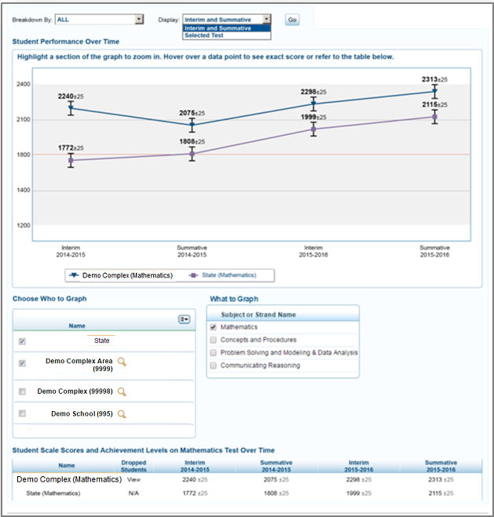
Trend Report Features
Choose Who to Graph
View Data by Demographic Subgroup
Choose What to Graph
Hide Trend Lines
Notes:
Trend reports are interactive. You can choose the tests, entities, and categories that should be plotted on the graph.
You may select up to five entities to compare at one time by checking the required boxes from the Choose Who to Graph section. A trend line for each selected entity will appear on the graph and will be color coded.
You may also choose to plot data points for a subgroup, such as ethnicity, by using the Breakdown By drop-down list near the top of the report.
You may select the overall test subject data (default) or individual reporting categories to plot from the Choose What to Graph section.
Finally, you may temporarily hide a trend line to better view data. Click the trends you want to hide from the trend reports legend box below the graph. The trend you have selected will become grayed out and the line will disappear from the graph. To display the trend line again, click the trend name again.

Slide 32
Reports & Files
Notes:
The Reports & Files drop-down menu provides access to additional reports through the Summary Statistics and Retrieve Student Results pages.
We will discuss how these pages function in more detail on the following slides.

Slide 33
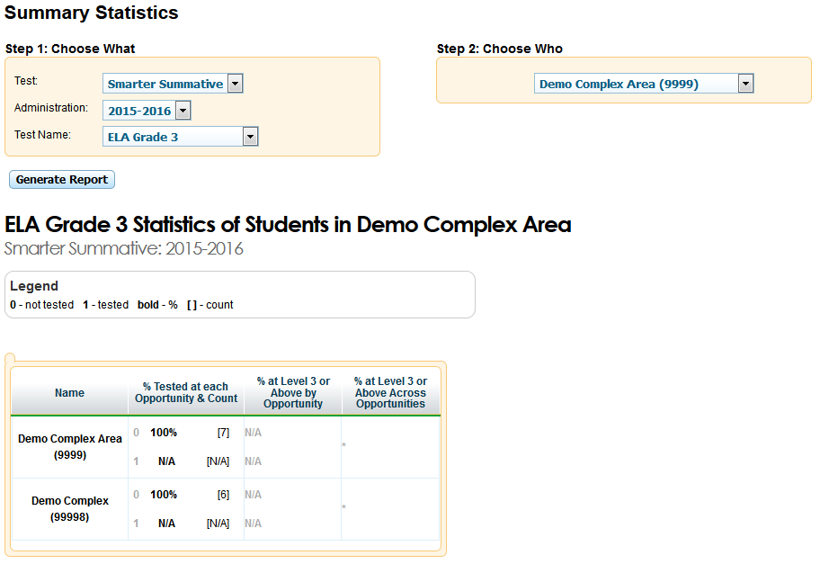
Test Management Center: Summary Statistics
Notes:
The Summary Statistics section displays statistics for students who have tested for a selected test by administration year and test name.
To generate a summary statistics report:
First, from the Reports & Files drop-down list, select Summary Statistics.
Next, select the test, administration, and test name for your report.
Finally, click Generate Report.
The report will show the number of students at each opportunity, as shown in this sample report. For example, students at “Opportunity 0” have not taken the test, students at “Opportunity 1” have taken the test once, and so on.

Slide 34
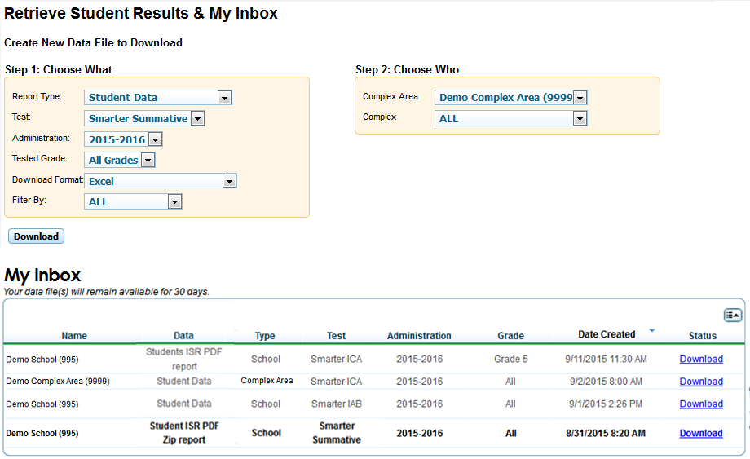
Test Management Center: Retrieve Student Results
Notes:
From the Retrieve Student Results section, you can download a ZIP file containing individual PDFs of each Individual Student Report for all the students associated with the selected school. The ZIP file will include a CSV manifest that lists all the PDFs included in the ZIP file.
You can also download student data files for a selected test window by complex area, school, teacher, or roster, depending on your user role. The data file contains students’ personal information, including enrolled school and grade level, and the selected test scores and claim scale scores, if applicable. You can download the data file in Excel or CSV format.
To generate a report:
First, from the Reports & Files drop-down list, select Retrieve Student Results.
Next, select a report from the Report Type drop-down list. You may download either Student Data or PDFs of Student Reports.
Then, select the parameters for your file from the available drop-down lists and click Download. You will be informed via email once the file is ready.
Finally, when your file is ready, click Inbox on the banner. Your file will be in the inbox. Click the Download link to save the file to your computer. Your file will continue to be available for 30 days in ORS.

Slide 35
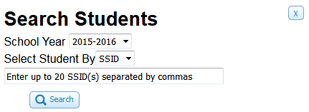
Search Students
Notes:
You can search for a student’s score reports by student ID. This is especially useful if you need to find a student’s score reports, but do not know the student’s grade or school (for complex area and state level users). This feature searches for score report results for students.
To search for multiple students at once, you can enter multiple SSID numbers separated by commas in the search field.

Slide 36
Search Students
Notes:
The Student Search Results page will show a list of students who match your search.
To view all tests taken by a student, click the plus sign.
To view a student’s score report for a particular test, click the test name.

Slide 37
View/Edit Rosters
Notes:
A roster is a collection of students sharing a similar characteristic who are assigned to a specific teacher. Rosters typically represent classrooms, but can also be used to group students with special needs or students participating in particular activities or programs. You can view how a roster of students performed on a test by selecting Roster in the “Who” drop-down list in the Score Reports exploration menu.
Based on your user role, you may be able to create and edit rosters, which can be done in TIDE and in ORS. For some users, rosters may need to be created in TIDE before data can be viewed in ORS.
To view or edit a roster of students, click the View/Edit Rosters tool in the banner.

Slide 38
View/Edit Rosters
Notes:
When you click View/Edit Rosters, the View/Edit Rosters popup window will appear. In this example, the complex area, complex, and school criteria are required.
Select either “user defined” or “system defined” from roster type. To look up rosters that you created, be sure that “user defined” is selected in the drop down menu.
Click Search to display a list of rosters matching your criteria.

Slide 39
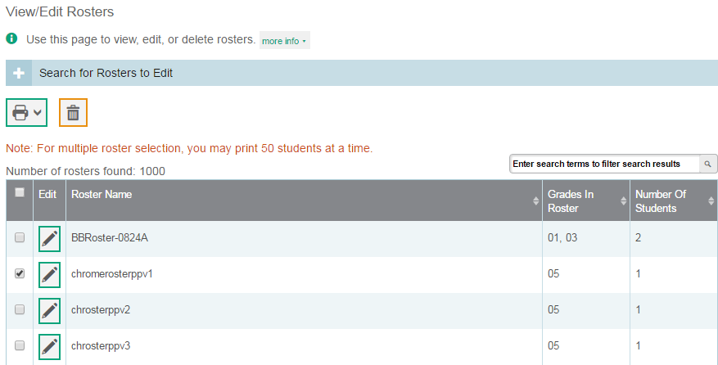
View/Edit Rosters
Notes:
Once the list of rosters has loaded, you may print or delete rosters, depending on your user role, by selecting them and clicking the Print or Delete button above the search results.
CAUTION: A roster cannot be recovered once it is deleted.
Click the pencil icon next to a roster to view or edit its details.

Slide 40
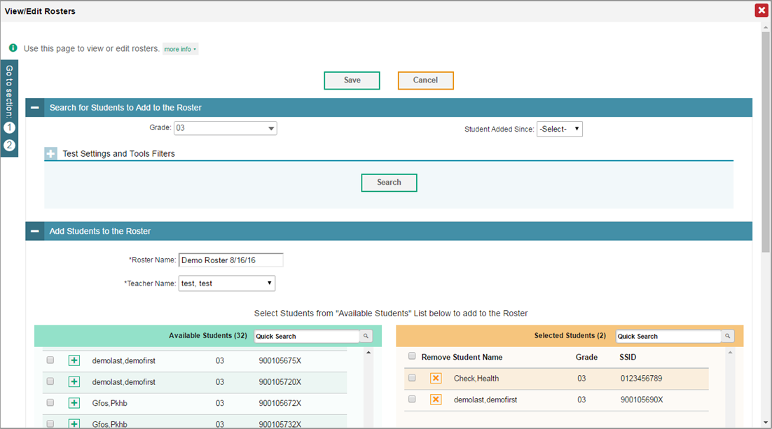
View/Edit Rosters
Notes:
When you click the pencil icon next to a roster, a new pop-up window will appear, allowing you to edit that roster’s name, teacher name, and students in the roster.
A list of students will appear in the Add Students to the Roster section near the bottom of the pop-up window. Students in the left column are available to be added to the roster, and students in the right column are currently in the roster.
To add students to the roster, select the necessary search criteria in the section titled, Search for Students to Add to the Roster. Click Search to display a list of students matching your criteria in the Available Students column.

Slide 41
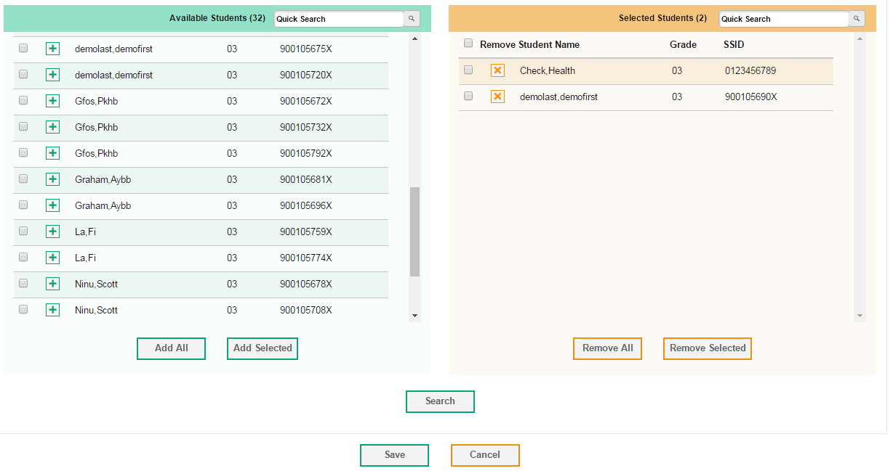
View/Edit Rosters
Notes:
To add a single student to the roster, click the green plus sign next to a student in the left column. You can add multiple students to the roster by marking checkboxes next to the students you want to add, and then clicking Add Selected. Add all available students to the roster by clicking Add All.
To remove a single student from the roster, click the orange X next to a student in the right column. You can remove multiple students from the roster by marking checkboxes next to the students you want to remove, and then clicking Remove Selected. Remove all students from the roster by clicking Remove All.
When you have finished editing your roster, click Save. You will return to the list of roster search results where you may view or edit additional rosters.

Slide 42
Add Roster
Notes:
You may wish to create a new roster in order to see how a particular group of students performed collectively. School-level users can create a roster of all students in a specific grade who have tested. You can create a custom list of students receiving special instruction or who belong to an extracurricular program to track their performance as a group.
Click the Add Roster tool to create a new student roster.

Slide 43
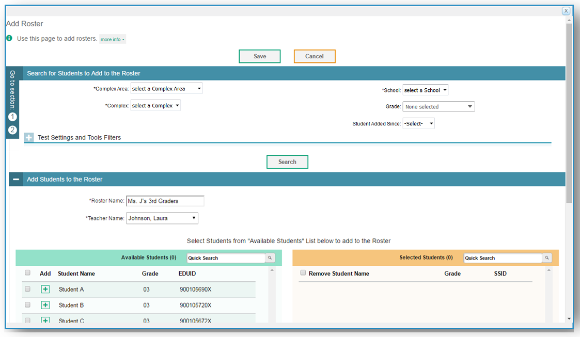
Add Roster
Notes:
When you click Add Roster, the Add Roster pop-up window will appear. To add a new roster, select the complex area, complex, and school to which the roster belongs. Enter a roster name and select the name of the teacher who should be associated with the roster. The roster name should be unique to that teacher and roster to avoid multiple rosters with the same name.
In Test Settings and Tools Filters, you may optionally refine the list of available students by selecting additional criteria from the drop-down lists and checkboxes. Then click Search. Students matching your search criteria will appear in the Available Students column near the bottom of the window.

Slide 44
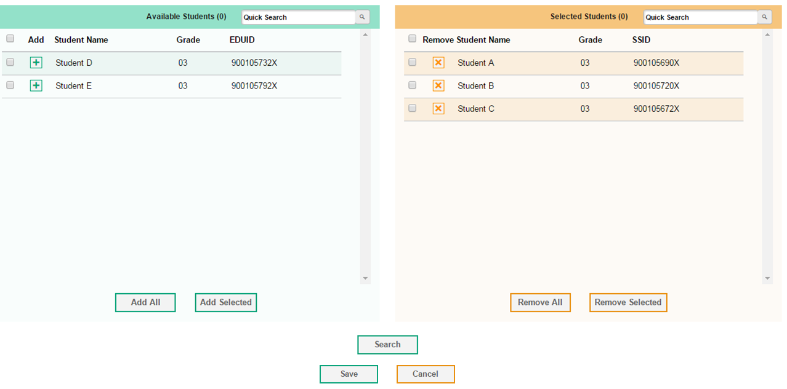
Add Roster
Notes:
To add a single student to the roster, click the green plus sign next to a student in the left column. You can add multiple students to the roster by marking checkboxes next to the students you want to add, and then clicking Add Selected. Add all available students to the roster by clicking Add All.
To remove a single student from the roster, click the orange X next to a student in the right column. You can remove multiple students from the roster by marking checkboxes next to the students you want to remove, and then clicking Remove Selected. Remove all students from the roster by clicking Remove All.
When you are finished adding students to the roster, click Save to create the new roster.

Slide 45
Things to Remember
The ORS helps educators answer questions regarding the assessment data in order to improve teaching and learning.
The magnifying glass icon displays the exploration menu, which is used to explore the different dimensions and levels of score data.
All reports can be printed and exported.
The Help button is available on every page of ORS.
You can use ORS to generate individual student reports to share with parents.
Notes:
Here are a few things to remember:
The Online Reporting System helps educators answer questions regarding the assessment data in order to improve teaching and learning;
The magnifying glass icon displays the exploration menu, which is used to explore the different dimensions and levels of score data;
All reports can be printed and exported;
The Help button is available on every page of ORS; and
You can use ORS to generate individual student reports to share with parents.

Slide 46
Thank You!
Further Information
Visit
alohahsap.org
www.smarterbalanced.org
Call, fax, or email the American Institutes for Research HSAP Help Desk
Hours: 7:30 am to 4:00 p.m. HST, Monday-Friday (except holidays)
Phone: 1-866-648-3712
Fax: 1-877-231-7813
Email: HSAPHelpDesk@air.org
Notes:
Thank you for taking the time to view this training module. For detailed information, consult your Online Reporting System User Guide located on the AlohaHSAP.org portal or contact the HSAP Help Desk.

