Slide 1
How to navigate the dashboard and access your summative & Interim results
The Centralized reporting system Series #1
Copyright © 2021 Cambium Assessment, Inc. All rights reserved.
Notes:
Welcome to the first training module in the Centralized Reporting System series: How to Navigate the Dashboard and Access Your Summative Results. This module is designed to teach you the basics of how to access your summative results and get you well on your way to using the advanced functions of the system.

Slide 2
Objectives
Navigate the Centralized Reporting system dashboards to view and filter results for:
  teachers, school- and complex-level users
  state-level users
Understand the Performance on Tests page for:
  filter options for school- and complex-level users
  aggregate results at state, complex, school, and teacher level
Analyze a specific test report for:
  roster and student results using the toggle tabs
  performance measures and sorting
Notes:
In this module, we show you the dashboard views for teachers and school-, complex-, and state-level users and explain how to filter your data so you can focus on results for specific tests.
Next, we show you how to use the features of the Performance on Tests page, the filter options for school- and complex-level users, and how to access aggregate result comparisons.
Finally, we review a specific test report for a summative assessment, the performance measures, and the sorting feature.

Slide 3
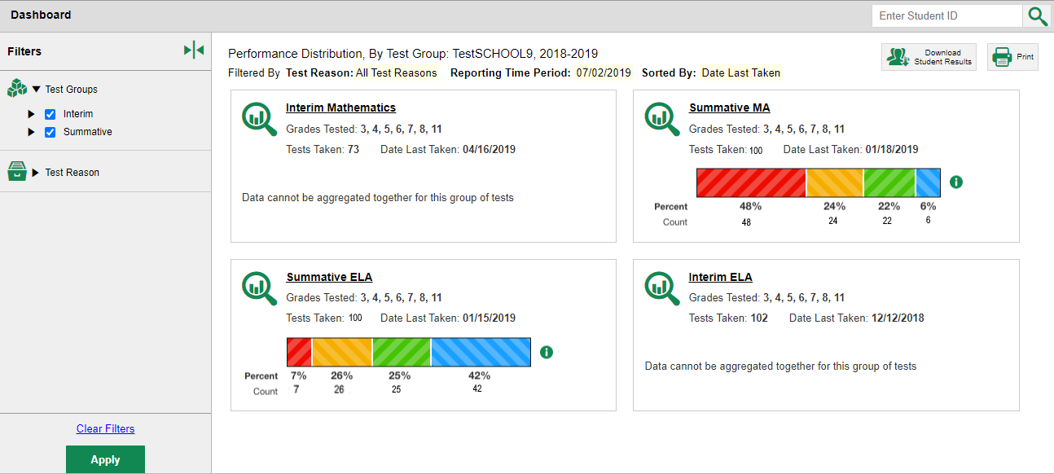
Dashboard
Notes:
After logging in to the Centralized Reporting system you see the dashboard. Test information and results are displayed for the students assigned to you based on your role.
A card displays for each test, by subject, with the grades tested and the number of tests taken.
The performance distribution results display as a color-coded bar with the percent proficient and student count listed under each colored level.
For example, 100 students across all grades took the Summative ELA test and of those students 7% performed in level 1; 26% in level 2; and so forth. The data on the Dashboard page gives teachers, administrators, and principals a way to quickly compare how their students performed across different test groups.
The cards are sorted in descending date order with the most recent test taken at the top.

Slide 4
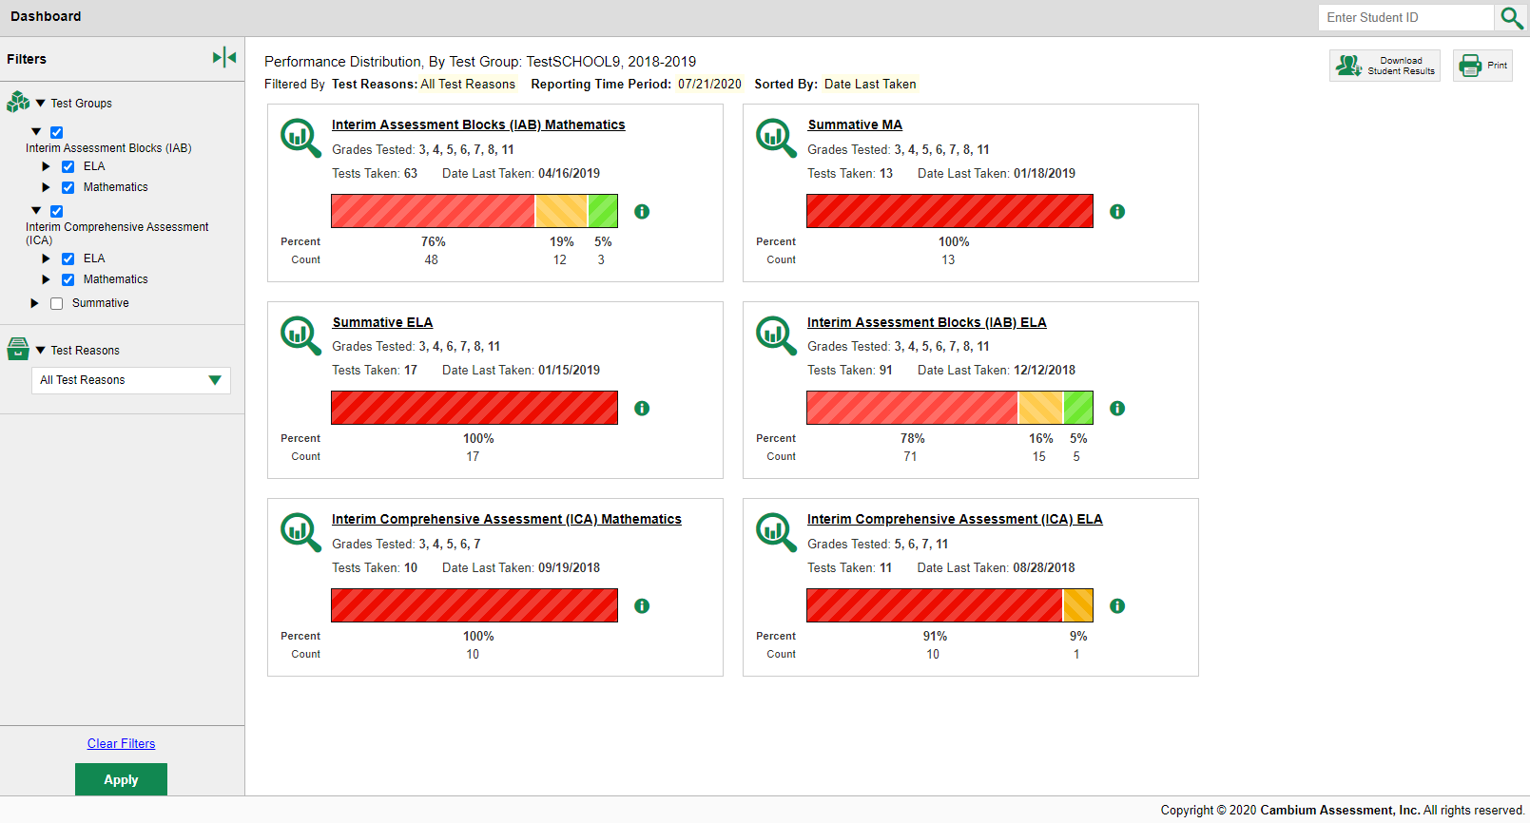
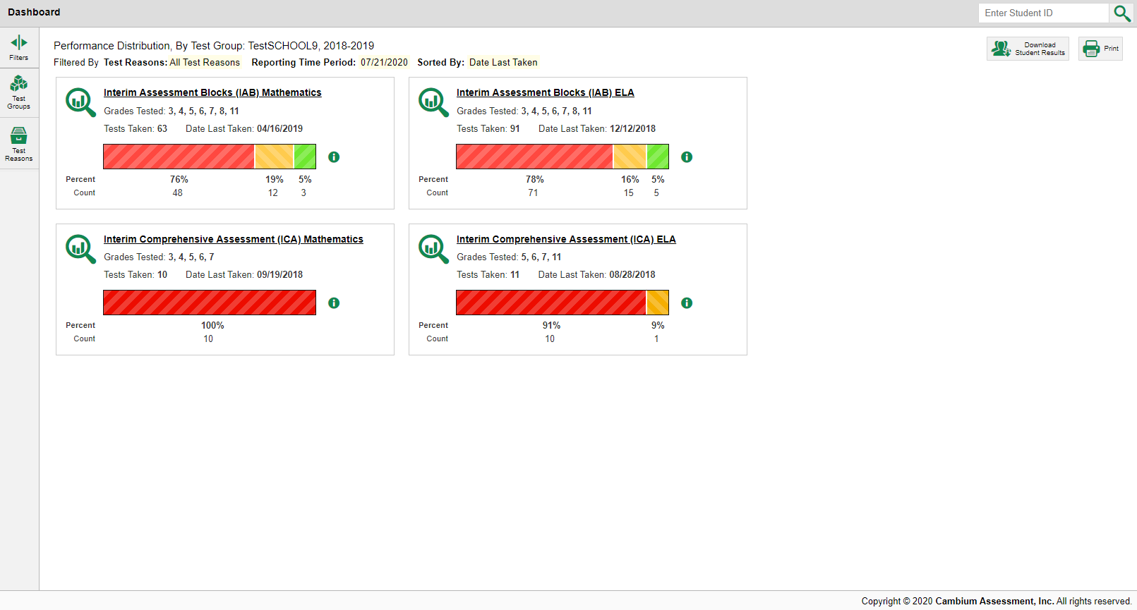
Dashboard: Filtering
Note: If your students have completed summative assessments, the dashboard is automatically filtered to display summatives only. If you would like to view interim assessment results, you will need to filter for those.
1
2
Notes:
If your students have completed summative assessments, the dashboard is automatically filtered to display summatives only. If you would like to view interim assessment results, you will need to filter for those.
1. To customize your dashboard to focus on the test results you want to see, open the Filters panel on the left and select specific Tests or Test Reasons from the drop-down menus.
2. Click the green Apply button and the dashboard updates.
In this example we filtered for the ELA and Mathematics Interim assessments and omitted the Summative tests. You get a quick comparison of results between the smaller Interim Assessment Block tests and the larger Interim Comprehensive Assessments in ELA and Mathematics.

Slide 5
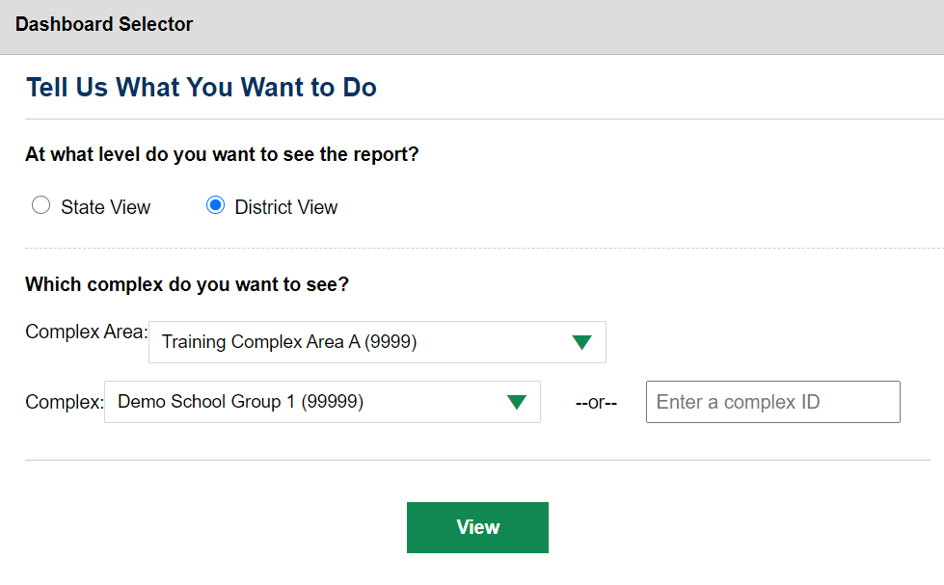
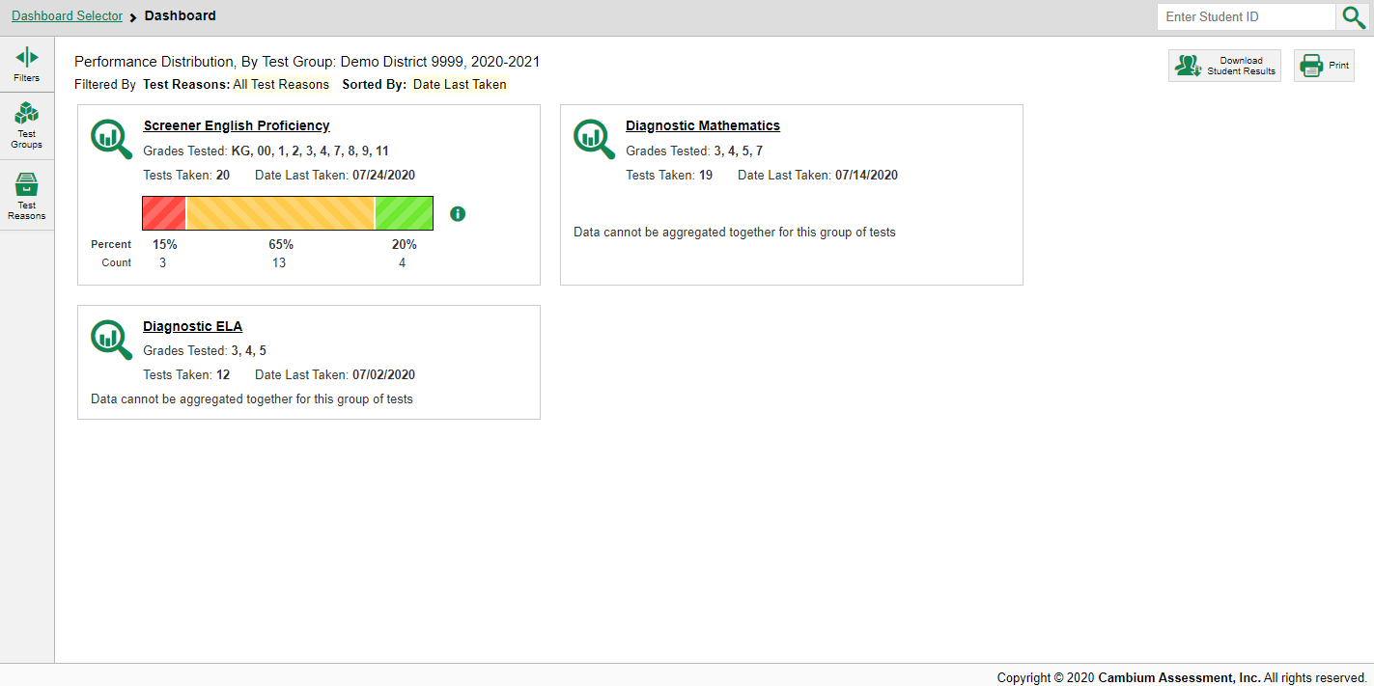
State-Level Users’ Dashboard Selector—District View Option
Notes:
State-level users see a Dashboard Selector page where you can select either State View or District View. To view a complex-level Dashboard, select an individual complex from the drop-down menu or enter a district ID in the search field. Click View and the complex Dashboard appears.

Slide 6
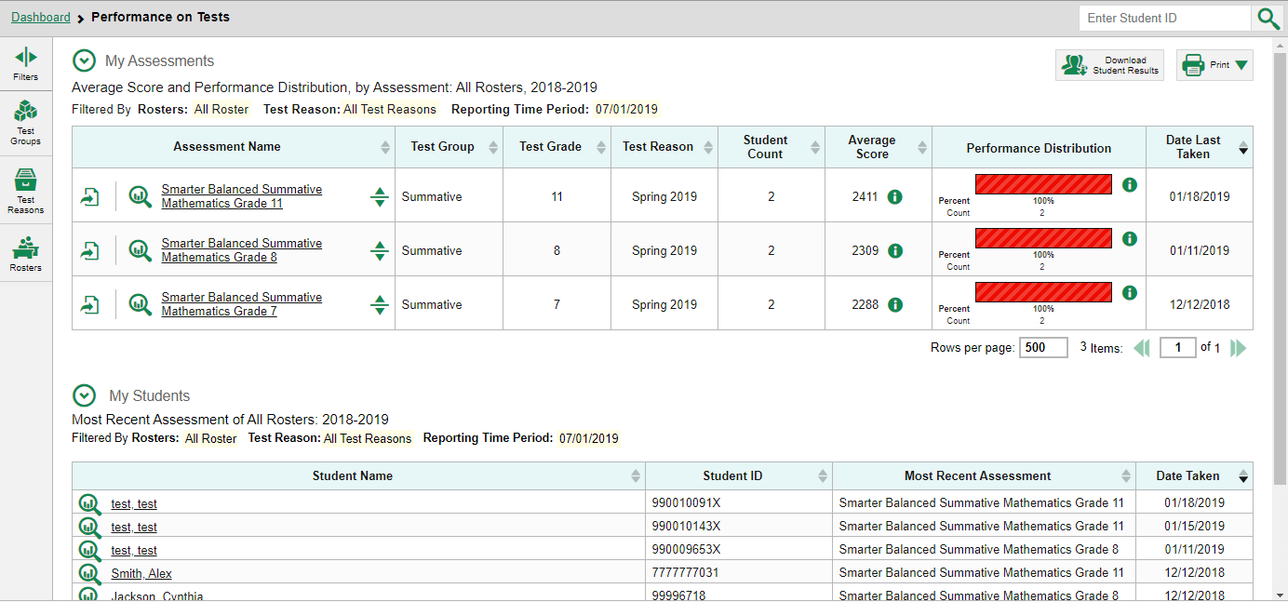


Performance on Tests Report for a Teacher—Page Layout
1
3
7
4
2
Notes:
Here you see the Performance on Tests page for a teacher who clicked on a Summative Mathematics test. The page displays two stacked tables, My Assessments on top and My Students below.
1. The My Assessments table lists the aggregate test results for the Summative Mathematics tests.
2. The My Students table lists all the teacher’s students who took those tests in order of the most recent test taken. This report is helpful when a teacher needs quick access to an individual student’s performance across tests.
3. Teachers can filter their Performance on Tests report by Test Groups, Test Reasons, and Rosters. Quick analysis can be done using the Performance Distribution column.

Slide 7
Performance on Test Report for a Teacher—Sorting Options
Test reasons are categories used to classify test opportunities for reporting purposes and a way to organize your data into meaningful groups for comparison.
1
3
2
4
7
4
5
Notes:
The Performance on Tests table headers display each filter selected in the columns.
Each row in the My Assessments table displays the name of the test, test group, test grade, test reason, the number of students who completed the assessment, the average score, the percentage and count of students in each performance level, and the date the test was last taken. You can use the table to quickly compare how your students performed across test groups. For example, you might see that a higher percentage of students performed above proficient in the grade 11 Mathematics test as compared to the grade 7 and 8 Mathematics tests.
Let’s take a moment to explain Test Reasons. Test reasons are categories used to classify test opportunities for reporting purposes and a way to organize your data into meaningful groups for comparison. Test reasons for summative tests are the testing window season and interim tests are typically Fall, Spring and Winter or interim 1, interim 2 etc. Test reasons are important because you can filter your data by the Test Reasons you select in the Filters panel.
You can sort your results directly from the Performance on Tests report by clicking each column header that has a set of expansion arrows in it.
For example, you might want to sort the Average Score column in ascending order to show tests with the lowest scores at the top of the table. You might want to sort the students in the My Students table alphabetically.

Slide 8
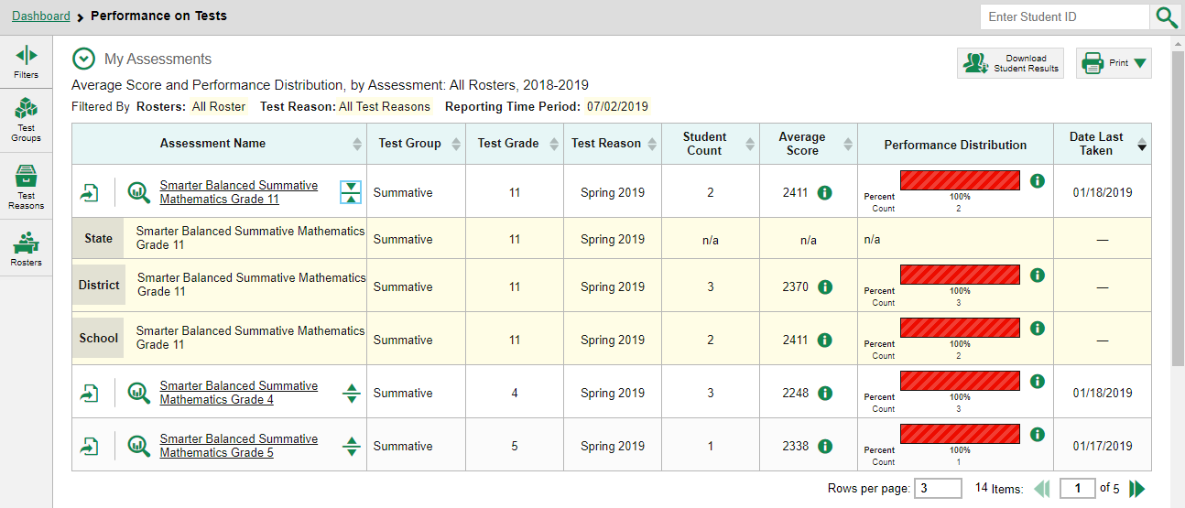
State, Complex Area, Complex Aggregates from Performance on Tests Report
You can compare your students’ results to aggregate state, complex area, and complex data in the Performance on Tests page by clicking the arrow to the right of the assessment name.
Notes:
You can also compare your students’ results to aggregate state, complex area, and complex data directly from the Performance on Tests page. Simply click the arrow to the right of the assessment name. The aggregates are highlighted in yellow on the report.

Slide 9
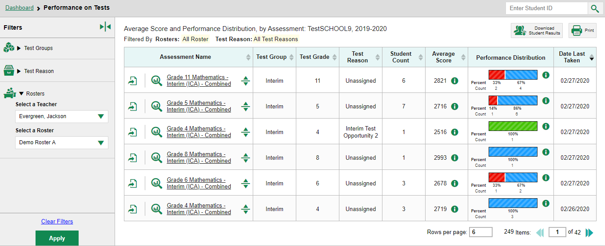
Performance on Tests Report for a Principal
2
1
Notes:
Here is the Performance on Tests page for a complex-level user who clicked on the Interim Mathematics test.
Each test is listed in the table. You can view the aggregate results for each test listed by clicking on the green arrows. This allows you to compare your student’s performance with district and state.
Complex users can filter their data by Test Groups, by Test Reason, and Rosters by Teacher and Teacher Roster.

Slide 10
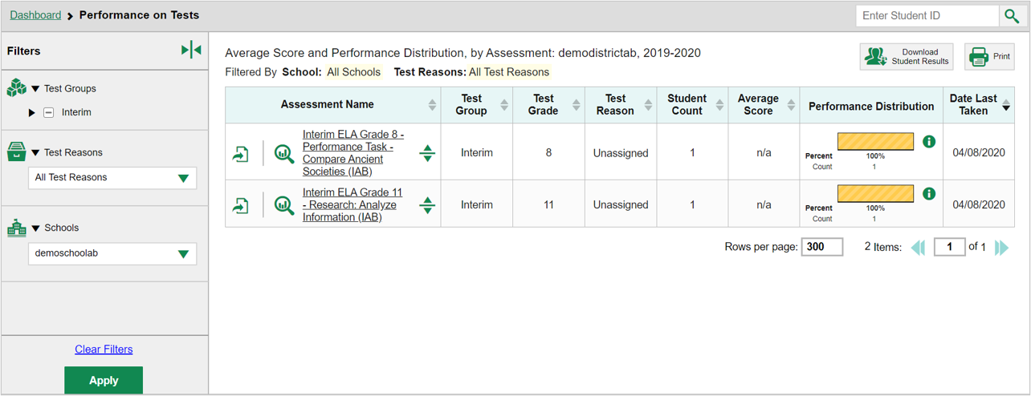
Performance on Tests Report for a Complex Area-Level User
Complex area-level users can select an individual school.
Demoschoollab, 2019-2020D
Notes:
For complex area-level users, the Filters panel includes a complex option so that the complex area-level user can select an individual school. This allows the complex area user to view results by each complex in the complex area instead of seeing aggregate results for the whole complex area.

Slide 11
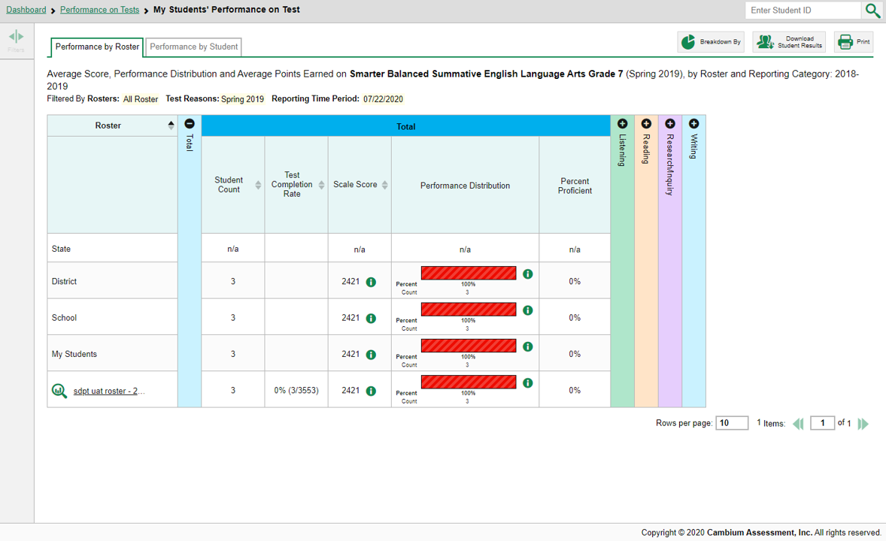
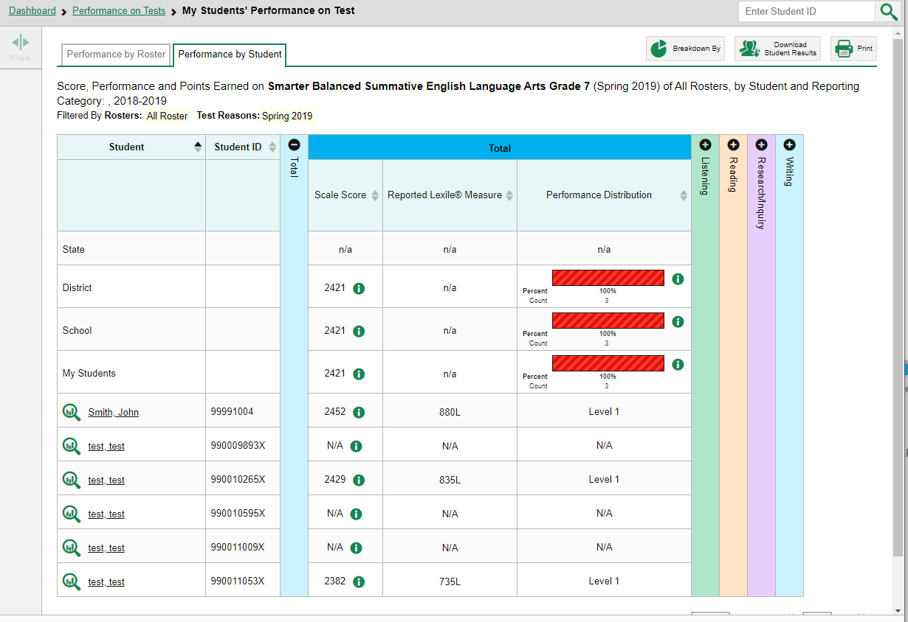
My Students Performance on Test Report-Page Layout
1
2
3
19
Notes:
In the My Studentsʻ Performance on Test page, complex users and teachers see two tabs on the navigation bar: Performance by Roster and Performance by Student. You can toggle between the tabs to change the data from a list of rosters to a list of students.
Here is a teacher’s Performance on Test page for the Summative English Language Arts Grade 7 assessment.
1. Performance by Roster on the My Students’ Performance on Test lists the teacherʻs class rosters in the left column and their performance with aggregate results for other students in your complex, complex area, and state. This data displays at the top of the table.
2. The accordion chart includes expandable sections to display each reporting category. This Summative ELA Grade 7 test includes four reporting categories. They are Listening in green, Reading in tan, Research and Inquiry in purple, and Writing in blue.
3. The Performance by Student page allows you to compare your students’ performance with aggregate results for other students in your complex, complex area, and state. This data displays at the top of the table.

Slide 12
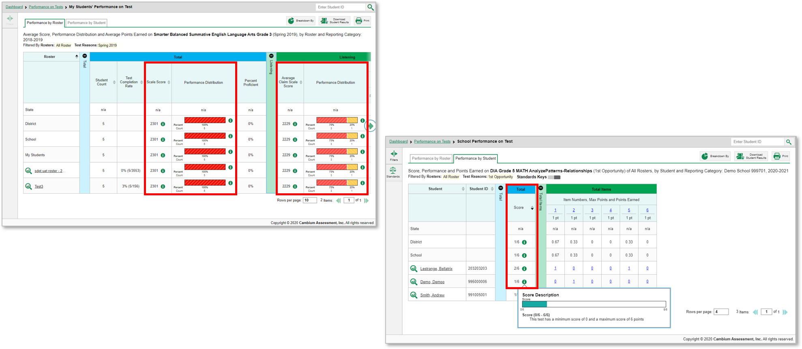
Performance Measures
1
2
20
Notes:
The performance measures used to report your data depend on your state or complex and the type of assessments administered. Typical measures include scale score and performance level.
Average scale scores and performance distribution bars are shown here for the Summative ELA test for Grade 3.
Score data can be displayed as scale scores or raw scores, like the score on this Grade 5 Checkpoint Math test. 1/6 is a raw score expressed as a fraction. Clicking the information buttons displays more information about the measures being displayed.

Slide 13
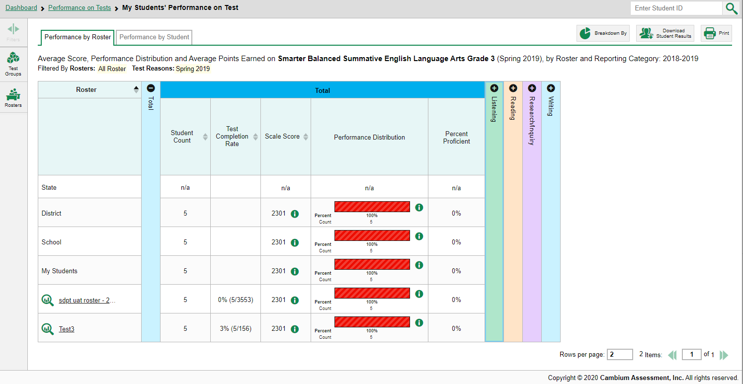
Sorting by Performance Measure
21
Notes:
You can sort your results by performance measure whenever you see a set of sorting arrows in the column header.

Slide 14
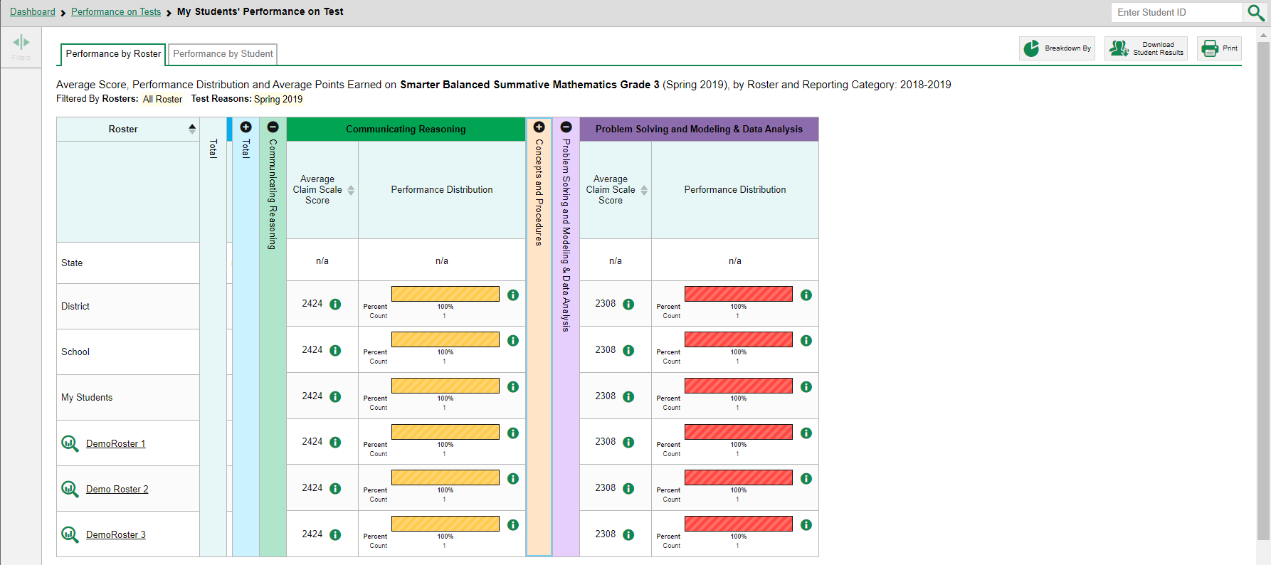
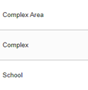
Performance Measures within a Reporting Category
The average scale score in each reporting category helps you understand how students performed on the different areas of the selected tests.
1
2
The information button displays more detail about the measures reported.
Notes:
In this example, we expanded the reporting categories to see the scores for Communicating Reason and the Problem Solving and Modeling & Data Analysis. The table displays the Average Scale Score for the State, Complex Area, Complex, and School along with the average scale scores for each roster.
1. The average scale score in each reporting category helps you understand how students performed on the different areas of the selected tests.
2. The information button displays more detail about the measures reported.
For example, a teacher might notice that their students are performing well in Math overall, but are struggling in the Concepts and Practices area because a percentage of the students are performing below mastery in that area. This helps educators identify the areas where students are struggling and where additional instructional support may be needed.

Slide 15
The Centralized Reporting System Series
1. How to Navigate the Dashboard and Access Your Summative Results
2. How to Understand Measures for Standards, Depth of Knowledge (DoK) Levels, and Writing Dimensions
3. How to Understand a Demographic Breakdown Report and a Student Portfolio Report
4. How to Drill Down into Your Results by Selecting Specific Tests & Classes
5. How to Drill Down into Your Results by Selecting Previous School Years & Previous Students
6. How to Track Student Performance Over Time Using the Longitudinal Report
7. How to Print Individual Student Reports (ISR) and Student Data Files
8. How to Print and Export Data You Can See in Your Reports
9. How to Use the Roster Manager to Add, Modify, and Upload Rosters
10. How to Analyze a Basic Interim Test Report
11. How to Use the Advanced Features of Reporting to View Interim Data
12. How to Hand-Score Unscored Items and Modify Machine Scores
Interim and Benchmark Assessments Only
Notes:
Thank you for viewing this module on navigating the dashboard and accessing your summative results. More modules are posted on the HSAP portal.

Slide 16
More Help
Further Information: The Centralized Reporting System User Guide for Summative and Interim Assessments, 2021-2022
https://alohahsap.org/
HSAP Help Desk
Phone: 1-866-648-3712
Email: hsaphelpdesk@cambiumassessment.com
Notes:
For detailed information, consult The Centralized Reporting System User Guide for Summative and Interim Assessments, 2021-2022, located on the HSAP portal, or contact the HSAP Help Desk.

