Slide 1
Remote Summative Test Administration
Test Administrator Training Module
SY 2022-2023
Copyright © 2021 Cambium Assessment, Inc. All rights reserved.
Notes:
Welcome to the Remote Summative Test Administration Test Administrator training module. This module will walk you through how to administer assessments to your students when they are not in the school building. To administer tests to students who are remote, you will use the same test administrator interface that you have been using prior to this to test to your students.
Please note that the features you see on your remote testing interface are dependent upon your state’s policies.

Slide 2
Objectives
This module will explain how you can do the following:
Prepare your computer and other technology before testing
Have adequate staffing for number of students scheduled in a test session (see next slide for guidelines)
Access the TA Live Site for remote summative test administration from home
Schedule a test in advance and modify a scheduled session
Convey session information to remote students
Join and begin a remote session that was scheduled in advance
Communicate with and assist remote students during a session
Pause and stop a remote test session
Notes:
This module will explain how you can do the following:
Prepare your computer and other technology before testing.
Have adequate staffing for the number of students scheduled in a single test session.
Access the TA Live Site for remote summative test administration site from home.
Schedule a test in advance and modify a scheduled session.
Convey session information to remote students.
Join and begin a remote session that was scheduled in advance.
Communicate with and assist remote students during a test session.
Pause and Stop a remote test session.

Slide 3
Remote Testing Overview
You use the same online testing system that is used to administer tests in the classroom. No additional software is needed.
You use the same test administration site to schedule and administer a test session in a classroom or remotely.
Remote students use the Secure Browser to access the test, and to access remote summative administration student-to-TA communication features.
Recommended student/test administrator ratio:
2 students: one test administrator
3 – 10 students: one test administrator + one proctor/TA
Notes:
It is important to remember one thing during this course: you will use the same online testing system that is used to administer tests in the classroom to administer tests to remote students. No additional software is needed to enable the remote testing capabilities.
This means that TAs log in to the same test administration site they would use if students were testing in the classroom. From this site, TAs can select a remote test session or a test session in a classroom.
Remote students use the Secure Browser to access the same testing website they would access in school, and the test takes place the same way it would if everyone were together in the classroom.

Slide 4
Security and Privacy
TAs and students will not be asked to share any additional personally identifiable information than they would share in an ordinary test session in a classroom.
For additional information, please see the HIDOE Remote Test Administration Guidelines on the AlohaHSAP.org portal site: https://smarterbalanced.alohahsap.org/resources/resources-2022-2023/remote-summative-test-administration-2022-2023
TAs will need to take and pass the Remote TA Certification Test PRIOR to administering the test.
TAs will need to have a WebEx session set up in advance for second device monitoring.
TAs will need to be able to record the WebEx session for upload into the Caveon Core system post-testing.
Students will need to have second device present and enabled for webconferencing (audio and video enabled).
Notes:
The option to test students remotely is built into the existing online testing system. TAs and students will not be asked to share any additional personally identifiable information than they would share in an ordinary test session in a classroom.
TAs will need to set up and be able to record a webinar session such as WebEx prior to testing for students to access with their second device for test monitoring. TAs will need to know where the recording file will be saved to their hard drive as they will need to find it again for upload to Caveon Core after testing. TAs will also need to be able to find the file to delete it after uploading to Caveon Core.
Students will be required to have access to a second device with audio and video capabilities and internet access for remote monitoring of student testing via webinar (ex. WebEX). Students’ cameras should be placed in such a way that their keyboard and hands are in view of the second device.
For additional information, please see the HIDOE Remote Test Administration Guidelines on the AlohaHSAP.org portal site.

Slide 5
Obtaining Parent and Student Consent
Parent or guardian and student consent is required for a student to participate in a remotely administered test session (signed Parent/Student agreement).
HIDOE Assessment Parent/Guardian Remote Test Administration Agreement Form:
https://smarterbalanced.alohahsap.org/resources/resources-2022-2023/remote-summative-test-administration-2022-2023
HIDOE Remote Test Administration Guidelines Spring 2023:
https://smarterbalanced.alohahsap.org/resources/resources-2022-2023/remote-summative-test-administration-2022-2023
Notes:
Parental and student consent is required for a student to participate in a remotely administered test session. Use the links to access the Parent/Guardian Remote Test Administration Agreement Form and the HIDOE Remote Test Administration Guidelines for Spring 2023.

Slide 6
Ensuring that You and your Students Have the Proper Hardware and Software
Hardware / Software | Who needs the hardware/software
Supported desktop or laptop running any supported version of Windows, macOS, or ChromeOS* | Test Administrators Students
Supported iPad running any supported version of iPadOS* | Students
Supported version of Chrome web browser | Test Administrators
Secure Browser | Students
Microphone, Speaker, and Webcam** (student test device and second device) | Test Administrators Students
Assistive Technology Software | Students requiring the use of assistive technology software such as text-to-speech or screen reader software
*For more information on supported devices, see: https://smarterbalanced.alohahsap.org/tech-guide.html#Supported_Devices
** In addition to the student’s webcam, a Webex session needs to be set up to view the student.
Notes:
Before taking a test from home, make sure that you and your students have the necessary hardware and software and that it functions properly.
Ensure that your testing device meets the following hardware and software requirements:
Your TA device has a supported version of the Chrome web browser installed so you can access the TA Live Site.
Students will need to ensure the Secure Browser is installed on their device.
Your TA device and the students’ testing device(s) will require a built-in or plug-in webcam, microphone, and speaker as well as internet connectivity. In addition to the student’s webcam, a Webex session needs to be set up to view the student.
Students in need of assistive technology, such as text-to-speech software or screen readers, will need this as well.
For more information on supported devices, see: https://smarterbalanced.alohahsap.org/tech-guide.html#Supported_Devices.

Slide 7
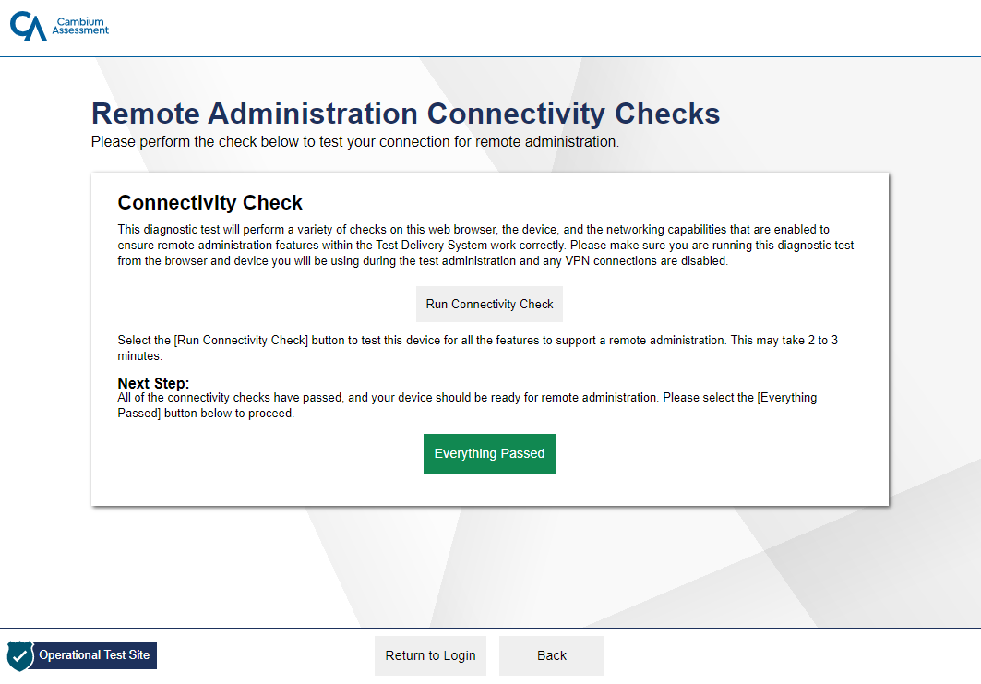
How to Test Remote Connectivity
Notes:
Before administering a test to students at home, it is recommended that TAs run the connectivity check to make sure their device, web browser, and network are properly configured to administer a test from home. When running the check, you should use the same device, web browser, and network you will be using to administer the test.
To run the remote connectivity check, go to the Network Diagnostics check located at the following URL: (https://bit.ly/check_my_speed).
Then select “Remote Connectivity Check” located at the bottom right corner of the page.
Next, select “Run Connectivity Check.” If your device, web browser, and network pass the connectivity check, you will see an “Everything Passed” button. This means that you should be ready to administer a test from home.

Slide 8
Ensuring a Remote Student’s Internet Speed is Fast Enough to Test
https://bit.ly/check_my_speed
Notes:
To ensure your internet speed meets the minimum recommended speed of 200 kilobits per second for administering a test from home, you should run a speed test prior to the day of testing. It is also very important to have your students perform this speed test prior to the day of testing.
To check your internet speed, you can use the Bandwidth Diagnostic check located at the following URL: https://bit.ly/check_my_speed
Once on the Network Diagnostics Page, TAs should select the third button that states “I am a test administrator who will be proctoring an exam remotely.” Next, select that you will be using your web camera. Then enter the number of students you will be testing at once in the box and select Run Test.
Once the diagnostic test is complete you will see three key pieces of information, your download speed, your upload speed, and a summary stating if you have enough bandwidth to test your students. In the example shown here, the download speed is 25.0 megabits per second and the upload speed is 5.0 megabits per second.
Students can use this same tool to check their home internet speed. If students are running the Bandwidth Diagnostic check , they should select the second button that states “I am a student who will be taking a test remotely.” They will then indicate they will be using their webcam and then select Run Test. The student will see the same download speed, upload speed, and report that the TA sees.
If the student’s internet speed is not fast enough to take a test at home, they should contact you to help troubleshoot the problem or to test using an alternate format.

Slide 9
How to Interpret your Speed Test Results
 | While you are administering a test and observing all students in snapshot mode: | While you are administering a test and observing one student in real-time high resolution: | While you are administering a test and conducting a one-to-one video conference with a student:
Recommended Download Speed | 20 kilobits per second per student | 20 kilobits per second per student plus 1.8 megabits per second for the student you are observing | 20 kilobits per second per student plus 1.8 megabits per second for the student with whom you are video conferencing
Recommended Upload Speed | 20 kilobits per second | 20 kilobits per second | 1.8 megabits per second
Notes:
Once the speed test results are displayed, compare the results with the recommended download and upload speeds in this chart. If you are testing many students at once, you will need to multiply the speeds in the chart by the number of students who will be taking the test.
For example, if you are administering a remote test to 10 students and are using video conferencing capabilities and observing all students in snapshot mode, you would need a minimum download speed of 200 kilobits per second.
If your internet speed does not meet the minimum recommended speed shown in this chart, video conferencing will still work. Video quality will automatically scale down to a level your internet speed can handle.

Slide 10
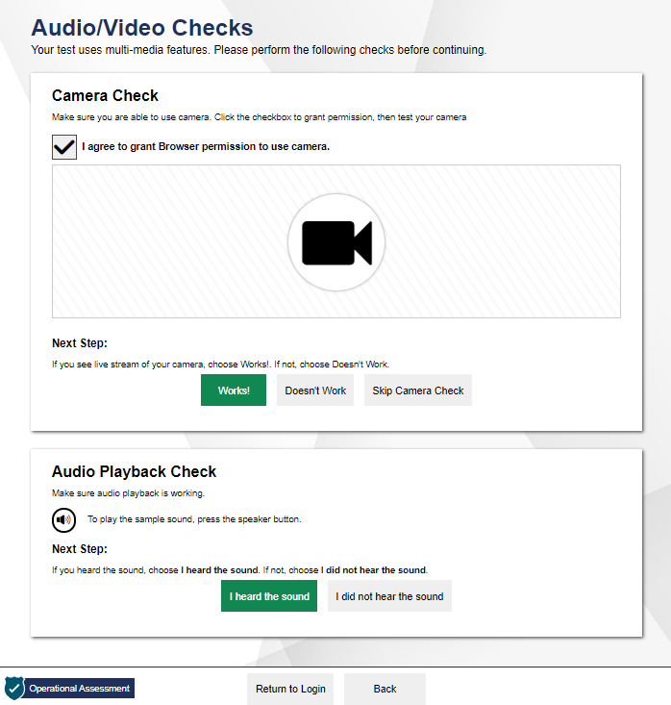
Ensuring that TA and Remote Student Hardware is Functioning
https://bit.ly/check_my_speed
Notes:
In addition to ensuring you and your remote students have the necessary hardware, you must ensure that the hardware is functioning correctly prior to the day you administer the test. You should ensure your webcam, microphone, and speakers are functioning properly and meet the minimum requirements necessary for remote testing,
To check that your hardware is functioning correctly prior to testing, go to the Network diagnostic check at https://bit.ly/check_my_speed.
This is the same Diagnostic Checker mentioned earlier to check internet speed. You can use this tool to check both your internet speed and your audio/video.
From here, select the Audio/Video Checks button. A series of audio and video checks will appear. To run the checks, follow the instructions for each individual check to determine if your hardware is functioning correctly.
Students should also be encouraged to run these audio/video checks before the day of testing. Students will also be asked to run a series of audio/video checks after logging into the student test site.

Slide 11
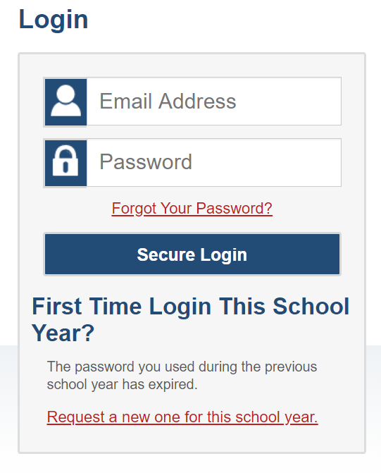
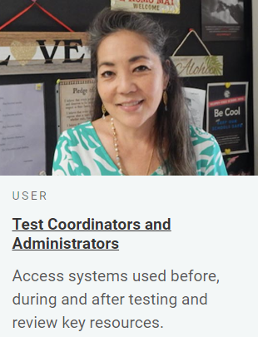
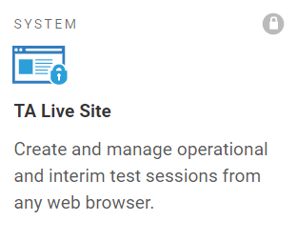
Accessing the Test Administration Site from Home
Notes:
To start a remote test session, you will go through the same steps that you would follow to administer a test session in a classroom with a few additional hardware checks that will allow you to communicate with students who are not in the classroom.
To log in to the test administration site, do the following:
Select the appropriate user role card from the AlohaHSAP portal.
Select the TA Live Site card to access the test administration site for the online assessments.
After selecting the card, you will need to log in with your username and password.

Slide 12
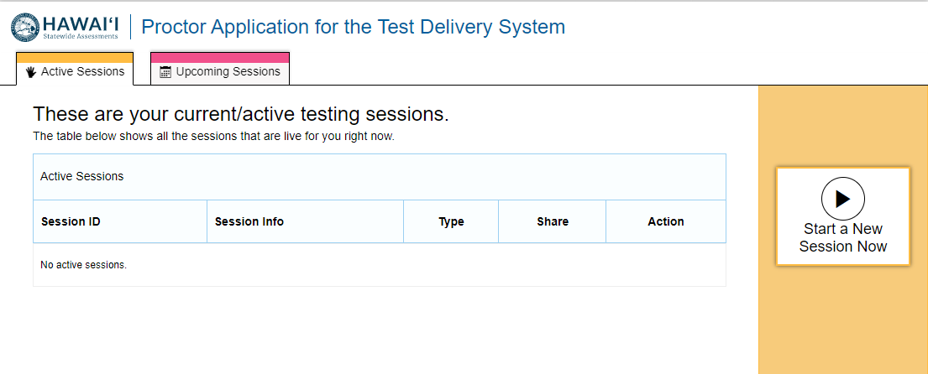
Viewing Your Session Dashboard
Notes:
Once you have logged in to the test administration site, you will see the Session Dashboard page.
The Dashboard page is where you can start a remote session, schedule a future test session, and share session links.
This page will display all your sessions, including Active Sessions and Upcoming Sessions.

Slide 13
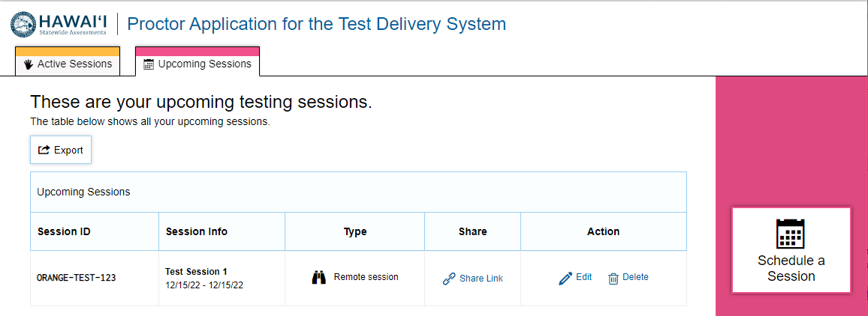
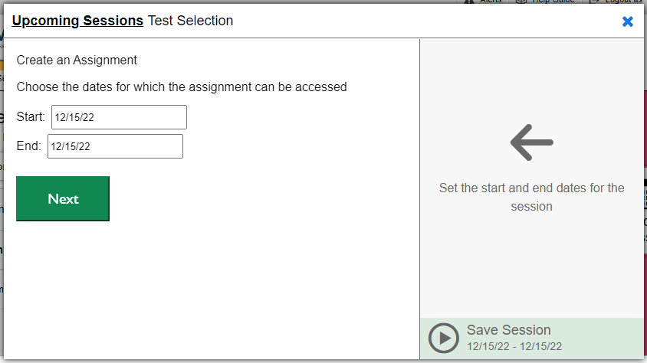
Scheduling a Remote Test Session in Advance
Notes:
There are two ways to administer a test to your remote students. The first way is to schedule a remote test session in advance. The second way to administer a remote test is to start a remote session immediately. We will first explain how to schedule a remote test session in advance.
Scheduling a remote test session in advance allows TAs to generate a link to the test session or a session ID they can share with their remote students before the day of the test.
To schedule a remote test session in advance, in the Upcoming Sessions Tab on the dashboard, select Schedule a Session.
In the pop-up window that appears, select a start and end date for the remote session and select Next.

Slide 14
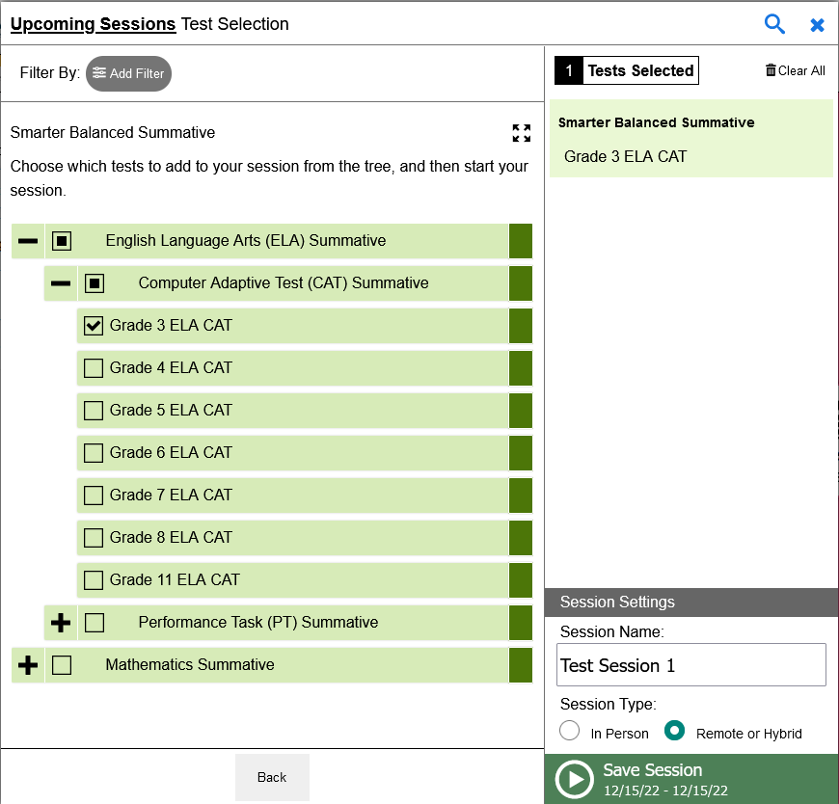
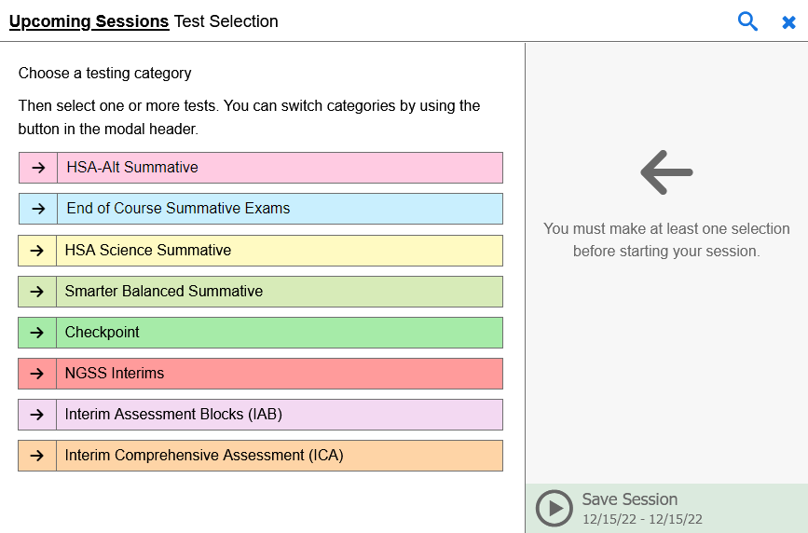
Selecting a Test to Administer to Students at Home
Notes:
Next, you will see a pop-up window with available test categories. Select the arrow next to the category to see all the possible tests you can select for your remote test session.
You can expand a list of tests by selecting the “plus” sign. You can collapse a list by selecting the “minus” sign. You may also add filters by selecting the Add Filter button.
Select the test or tests you want to add to the session by marking the checkboxes next to each test you want to add. Selected tests will appear in the right column. Once you are finished selecting tests to add, enter a name for the session in the Session Name field and select a Session Type, either “In Person” or “Remote or Hybrid.”
Remote sessions are when all students taking a test are at home. Hybrid sessions are when some students taking the test are at home and some students are taking the same test in the classroom. When administering a hybrid session, audio and video features added for remote testing will appear for all students, even those in the classroom. Due to the difficulty in monitoring both in-person and remote testing students simultaneously, especially if technical issues arise for remote testing students, this is not recommended.
When you are finished adding tests, select Save Session.

Slide 15
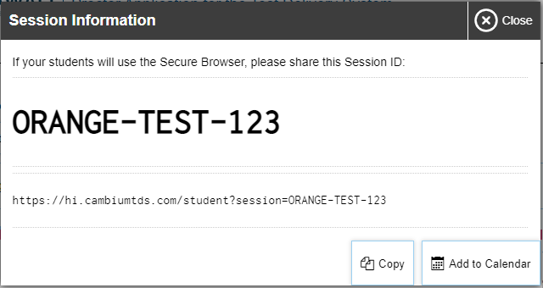
Sharing Remote Test Session Links with Students
Session ID
Notes:
After you have selected the tests you would like to administer remotely to your students, a pop-up window appears with a session ID. TAs should provide this ID to their remote students so students can access the test via the Secure Browser.
Select “Copy” to copy the session information to your clipboard. You can also add the session information to your calendar by selecting “Add to Calendar.”
This information should not be shared over unsecured communication methods like personal email or text message. Instead, teachers should communicate this information to students using a secure method such as whichever classroom management system teachers and students are already using for instruction purposes.

Slide 16
Beginning a Remote Test Session Starting Immediately
Notes:
Now let’s walk through starting a remote test session immediately. If you want to start a remote test session immediately, from the Active Sessions tab, select Start a New Session Now. Add tests in the same manner as you would to schedule a remote session and select Start Session.

Slide 17
Editing a Remote Test Session Scheduled in Advance
Notes:
Now let’s turn to how you can edit a remote test session that was scheduled in advance. TAs may want to edit a session after it was created to add tests or change the start or end time of the session.
If you wish to edit remote tests sessions that you have scheduled in advance, you can do so at any time before the session starts.
To edit a session, select the Upcoming Sessions tab to modify an existing remote test session.
Select Edit for the remote test session you want to edit. To delete a session, select Delete.

Slide 18
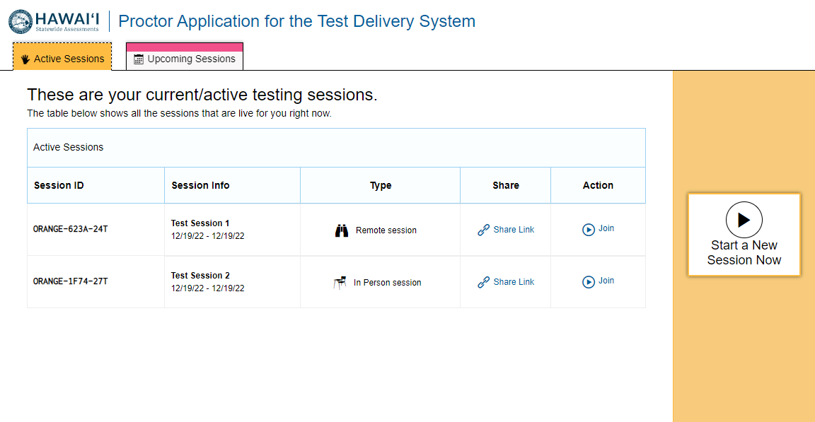
Joining a Remote Test Session to Open the Session
Notes:
On the day of the test, the TA must join the remote session that was scheduled in advance in order to open that session so students can be approved to begin their remote tests. This should be done no more than 30 minutes before the session begins in order to prevent the session from timing out. Remote students will not be able to take the test until you join the session.
Note that test sessions scheduled in advance automatically move from the Upcoming Sessions tab to the Active Sessions tab.
To start the test session, select Join for the session you want to start.

Slide 19
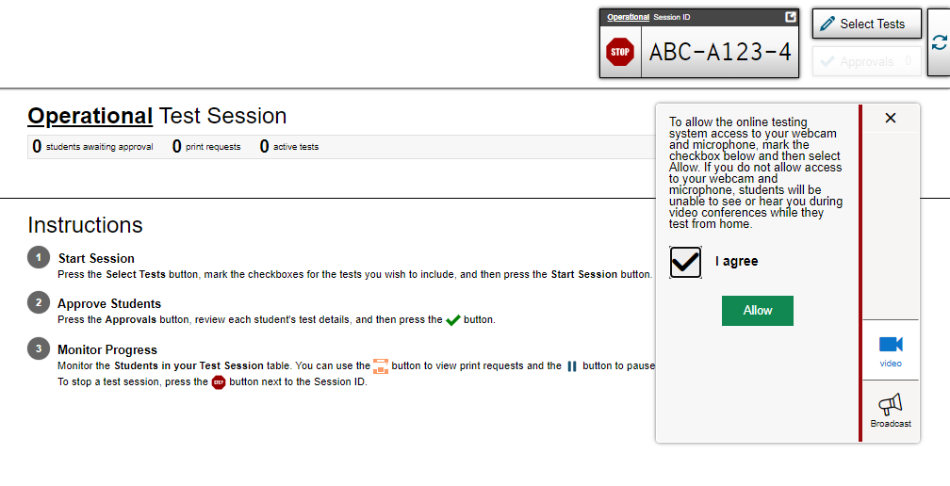
Allowing the Online Testing System Access to Your Webcam and Microphone
Notes:
You will need to allow the online testing system and your web browser access to your webcam and microphone. After starting a remote test session, a pop-up window appears in the test administration site, requesting access to your webcam and microphone. Mark the I agree checkbox and then select Allow.

Slide 20
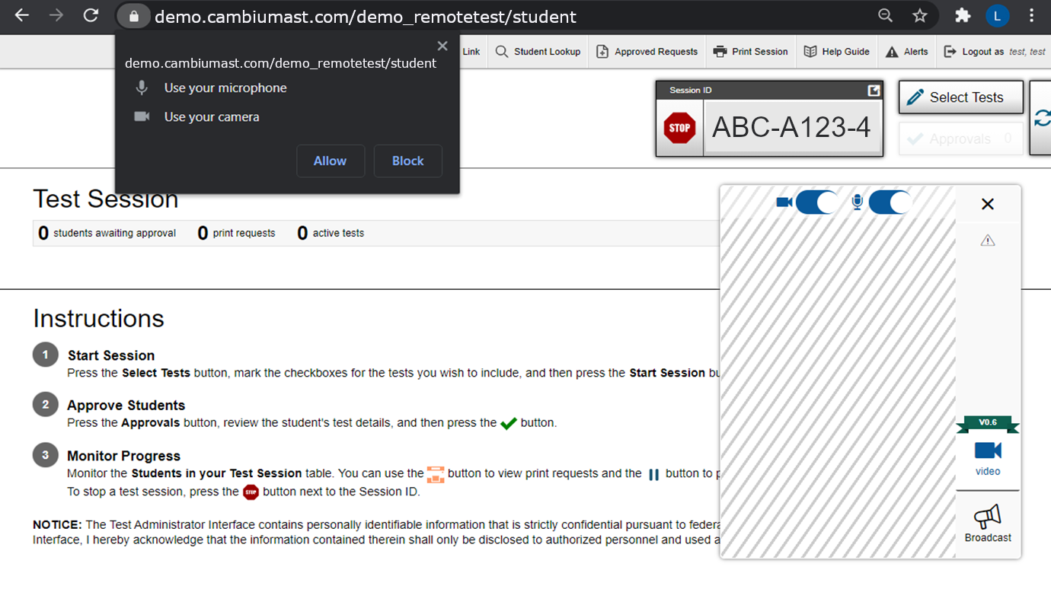
Allowing Your Browser Access to Your Webcam and Microphone
Notes:
You will also need to allow your browser access to your webcam and microphone. To do so, from the pop-ups that appear, select the option to allow access to your webcam and microphone to proceed. The alert shown here is from the Google Chrome browser.

Slide 21
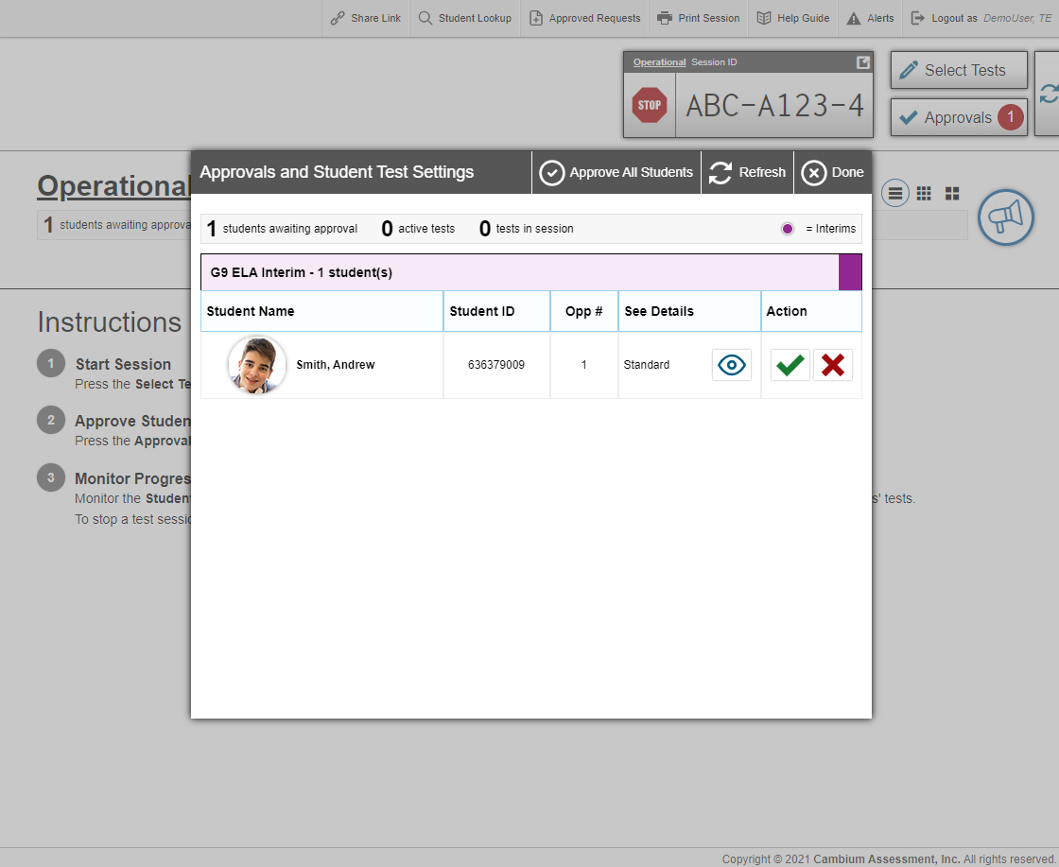
Approving Students to Take a Test
Notes:
After students sign into the testing system and select the test they need to take, you will see an Approvals button in the top right corner of your screen that shows many remote students are waiting for approval. To view which students are waiting for approval, select the Approvals button.
The Approvals and Student Test Settings pop-up window appears. This screen is when you can now start communicating with the remote students that are waiting for approval. We will discuss the various communication features on the next few slides.

Slide 22
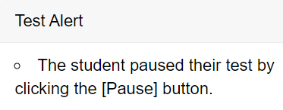
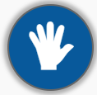
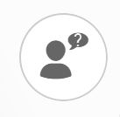
Communicating with Students
Communication/ Monitoring Feature | Who initiates the communication | How to use the feature
Broadcast Message | TA initiated | The TA uses this feature to send a chat message to all students at one time. Students can respond by sending a chat message to the TA.
Test Alert | Student initiated | TAs will receive an alert if the testing system detects a problem with the student’s test.
Screenshare Feature | TA initiated Student must grant permission | TAs can view a student’s screen after student grants permission.
Chat Message | TA or student initiated | Both the TA and student can communicate at any time beginning when the student is waiting for the TA to approve students.
Video Conference | TA initiated | TAs and students can have a one-to-one video conference.
Raise Hand Feature | Student initiated | Students can request help by virtually raising their hand. TAs can respond via chat message or video conference.
Lobby Feature | Student | Students can request teacher assistance via a chat message prior to logging in to the testing system. Teachers can respond via chat message.
Notes:
Before we go into detail about when and how to communicate with remote students through the testing system, let’s take a quick look at the various communicate features that are available.
This table lists the various communicate features that can are available through the testing system and when each feature is available.
The features available include the broadcast message feature, chat feature, raise hand feature, screenshare feature, video conference feature, and test alerts.
Let’s take a closer look at each of these communication features.

Slide 23
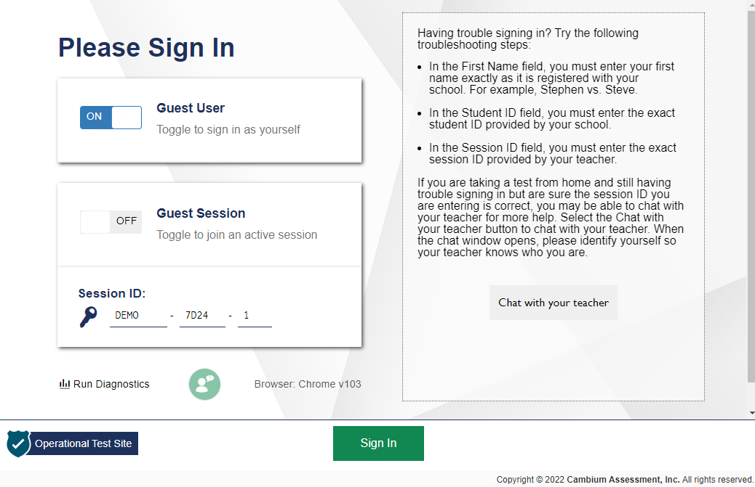
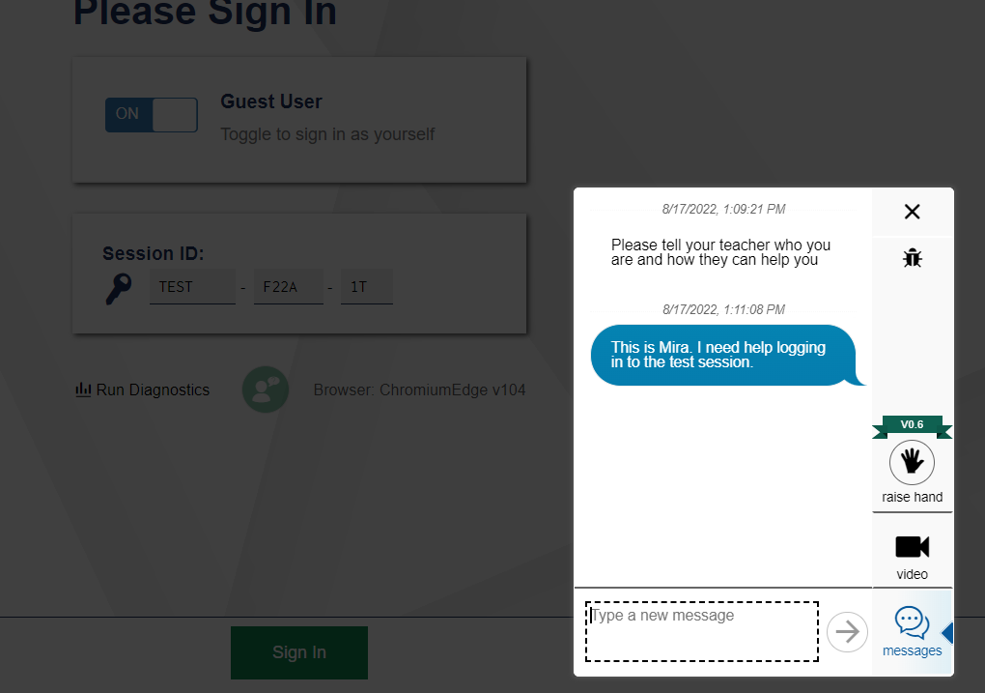
How Students Can Communicate Using the Lobby Feature
Student Screen
Chat widget
video
chat
Notes:
First, let’s review the Lobby Feature.
For states that have enabled the lobby feature, students and TAs can communicate by text chat (or by video for states that have enabled the video feature) before students log in to take a test. This may help students who are having trouble logging in.
If students need assistance prior to logging in, they can select the chat widget on the login screen. The student will see a screen with troubleshooting steps and a button to chat with their TA. Once the student selects Chat with your teacher, they will see a chat box. Because the student has not yet logged in, they will need to identify themselves by entering their name in the chat box. The student does not have to enter their name as registered in the system. However, after the student logs in, their name will display as it is registered in the system. The student can then type a message in the box and send it to you by selecting the arrow button.
For states that have the video feature enabled, students can request a one-to-one video conference by selecting the video icon. Students must also consent to being observed through their web camera.

Slide 24
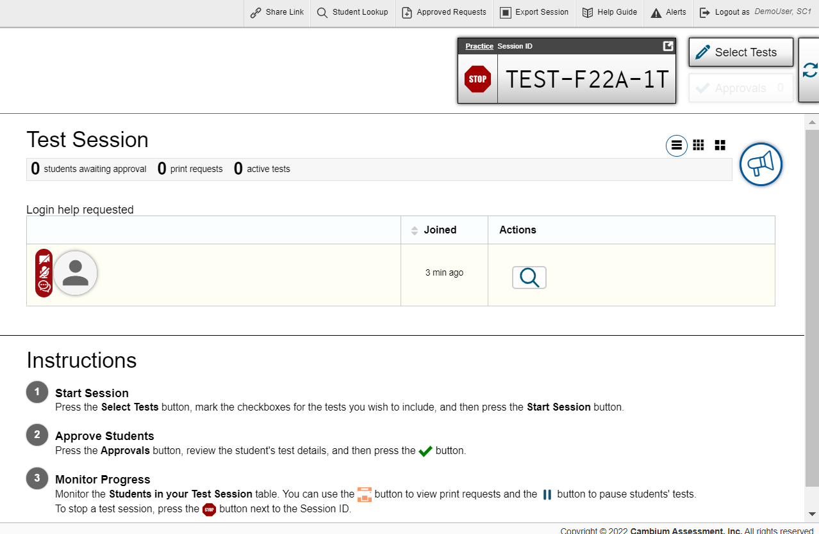
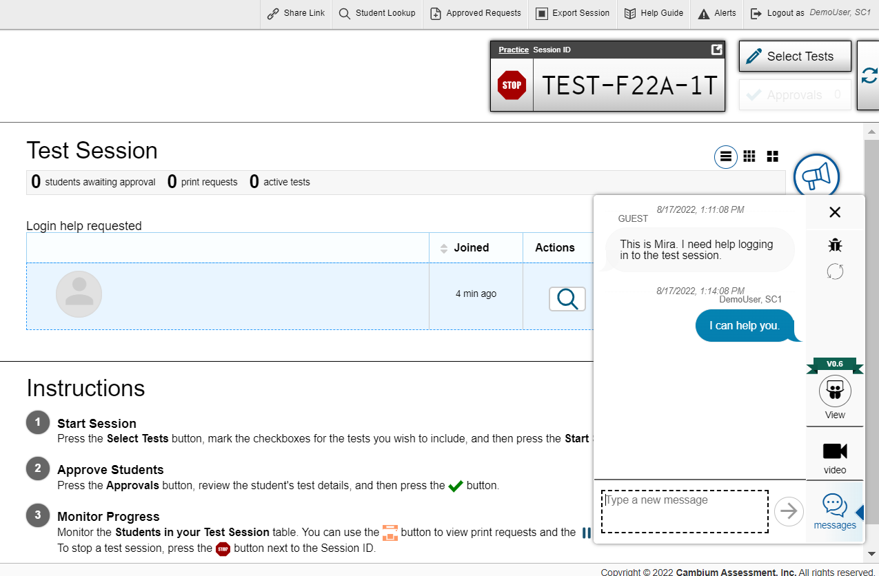
How to Communicate Using the Lobby Feature
TA Screen
Notes:
Once the student sends a chat message, the student will appear in the Login help requested table on the Test Session page on the TA’s device. Select the speech bubble icon to see a chat box with the student’s message. Type a chat message to respond to the student, and it will automatically show on the student’s screen. Once the student closes their chat window, the student will no longer appear in the Login help requested table.
You can also start a one-to-one video conference by selecting the video icon next to the student’s name. You will then be able to see and hear the student.

Slide 25
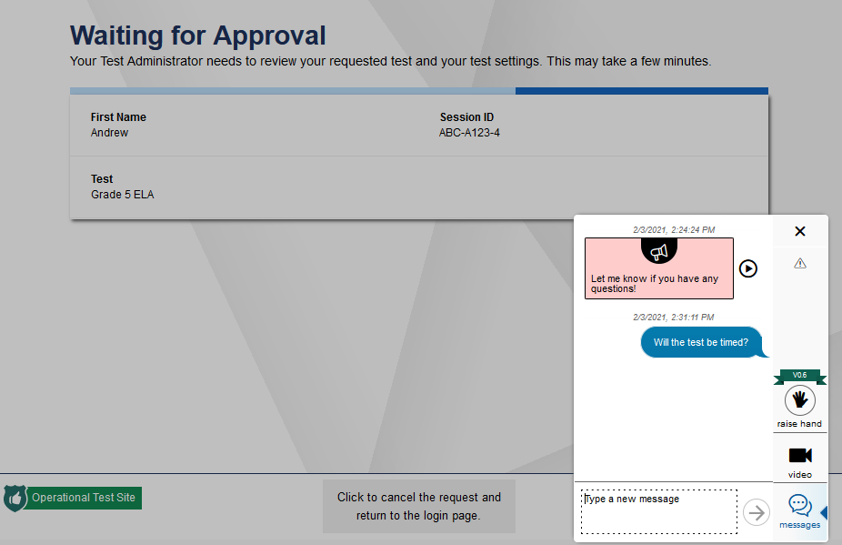
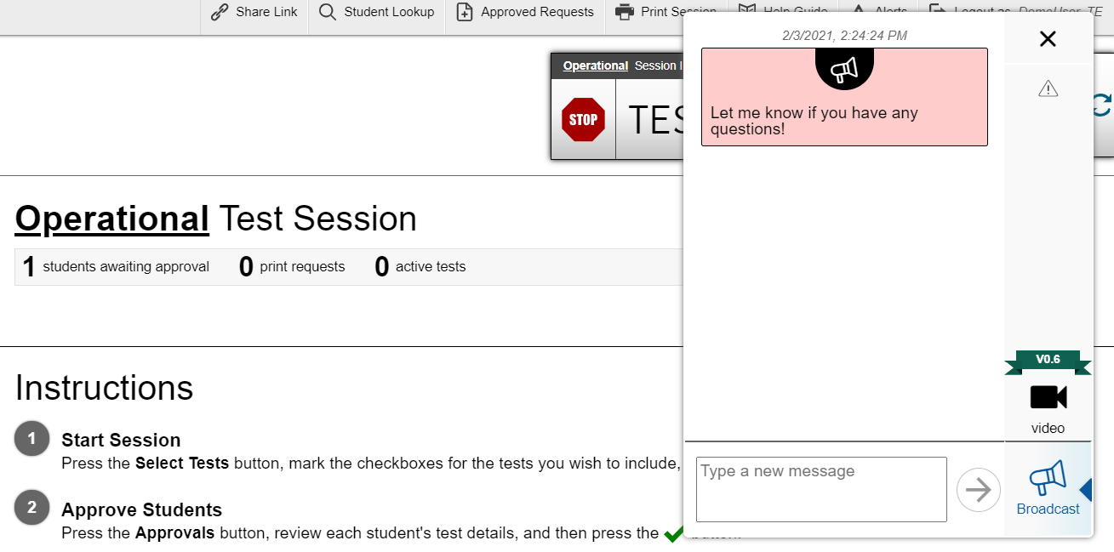
How to Broadcast a Message to All Students at Once
TA Screen
Student Screen
Notes:
First, let’s look at the Broadcast Message feature.
TAs can communicate with all remote students at once through a broadcast feature on the test administration site. Broadcast messages should be used to send important brief messages such as “Let me know if you have any questions” or “Ten minutes left in the test!” Please do not share PII such as student IDs to all students.
To send a broadcast message to all remote students at once, select the megaphone icon located at the top-right corner of the test administration interface. Type the brief message you want to send to all remote students and select the Arrow button.
The message will automatically appear on each student’s screen. Students can respond to the broadcast message by sending a chat message back to the TA. The chat message will only be visible to the TA and will not appear on any other student’s screen.
It is important to note that broadcasted messages will only appear for students who have joined the test session. If a student joins a session after a message is broadcasted, that message will not appear for that student.

Slide 26
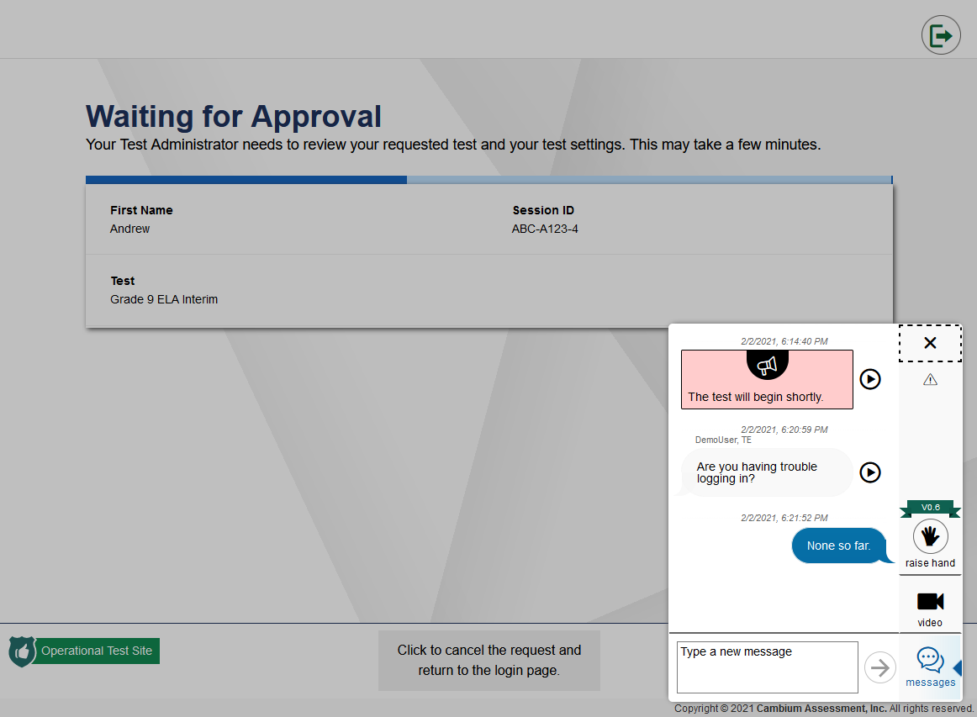
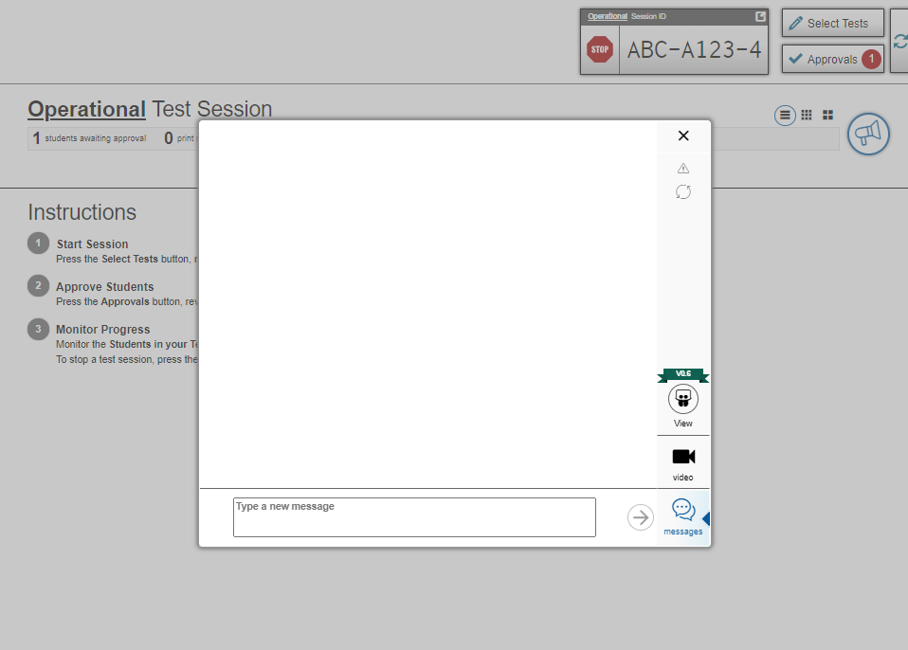
How TAs and Students can Communicate via Chat Message
TA Screen
Student Screen
Type a message
Chat message notification
Notes:
A second way TAs can communicate with remote students is via chat message.
If you want to send a chat message to a student that is waiting for approval, select the student’s video icon. In the chat window that appears, select the messages icon and type a message into the messages box. Select the arrow button to send the message. Note that this message is seen only by the student you are sending it to, and no other students will see the message.
On the student screen, the student will see a red speech bubble on the student video icon that appears in the bottom right corner of their screen. When the student selects the student video icon, a window will appear that will display the chat message you sent to that student.
The student can send a chat message back to the TA by typing a message into the messages box and selecting the arrow button to send the message. If a student sends a chat message, you will see a red speech bubble appear next to the student’s video icon on the Test Administration site. Select the student video icon to open the chat feature and show the student’s message.

Slide 27
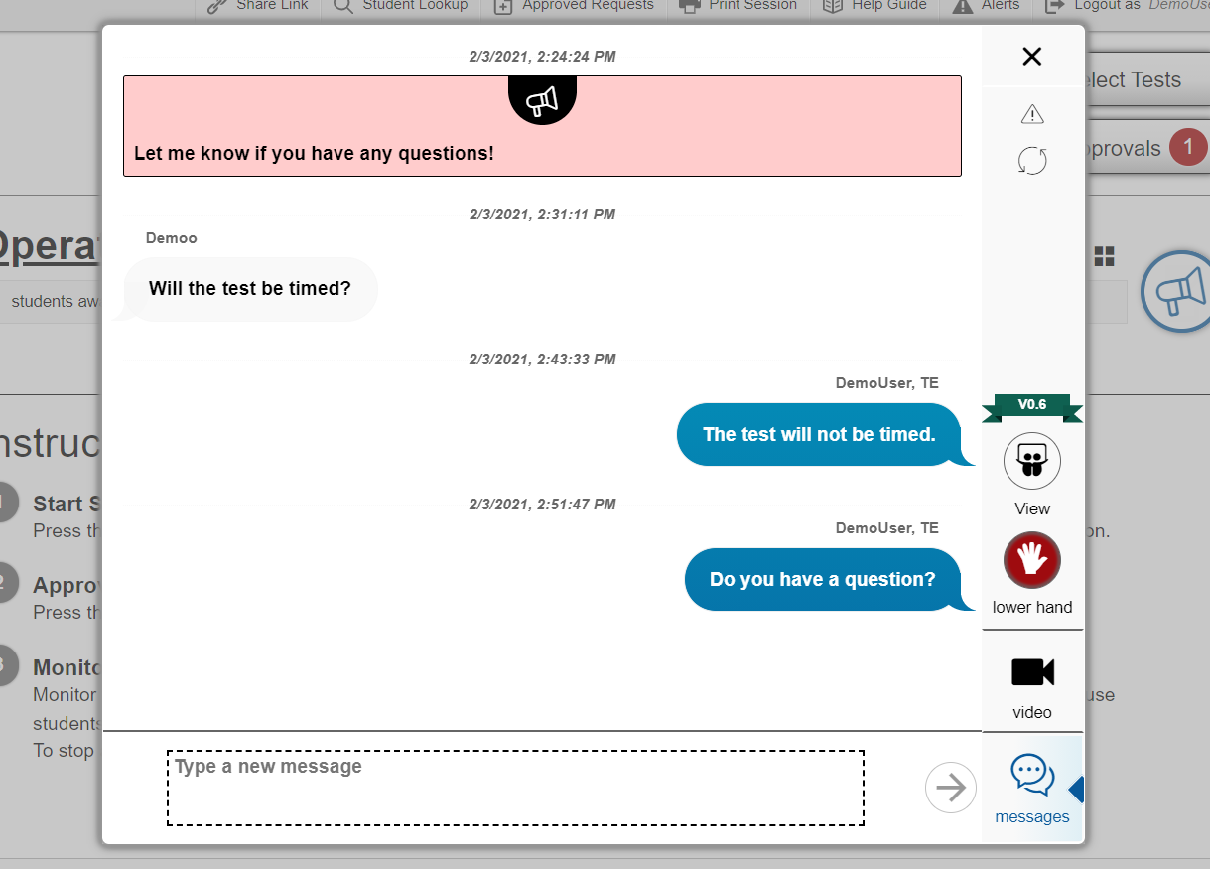
How TAs and Students can Use the Raise Hand Feature
Student Screen
TA Screen
Student raises hand
Lower student’s hand
Chat message to student
Notes:
The third way TAs and students can communicate is by using the Raise Hand feature.
If a student needs assistance, the student can request help by virtually raising their hand using the Raise Hand feature. To virtually raise their hand, the student will select the Raise Hand icon from the chat window.
If a student raises their hand, the TA will see a red hand icon next to the student’s image or icon in the Approvals and Student Test Settings window. To respond to the student’s raised hand, the TA can select the student’s video icon. In the chat/video window that appears, the TA will see the raise hand icon highlighted in red. To respond to the student, you can type a chat message in the message box and send it to the student. The student will receive the message and can respond if additional assistance is needed.
After you respond to the student’s raised hand, then you can select the red raise hand icon in the chat/video window, and this action will “lower the student’s hand.” The red hand icon will no longer appear next to the student’s video icon in the Approvals and Student Test Settings window on the test administration site.
The hand icon in the student’s chat/video window will no longer appear in red letting the student know that the TA has lowered the student’s hand.
If the student wants to lower their hand, they can do so by selecting the Raise Hand icon at any time.

Slide 28
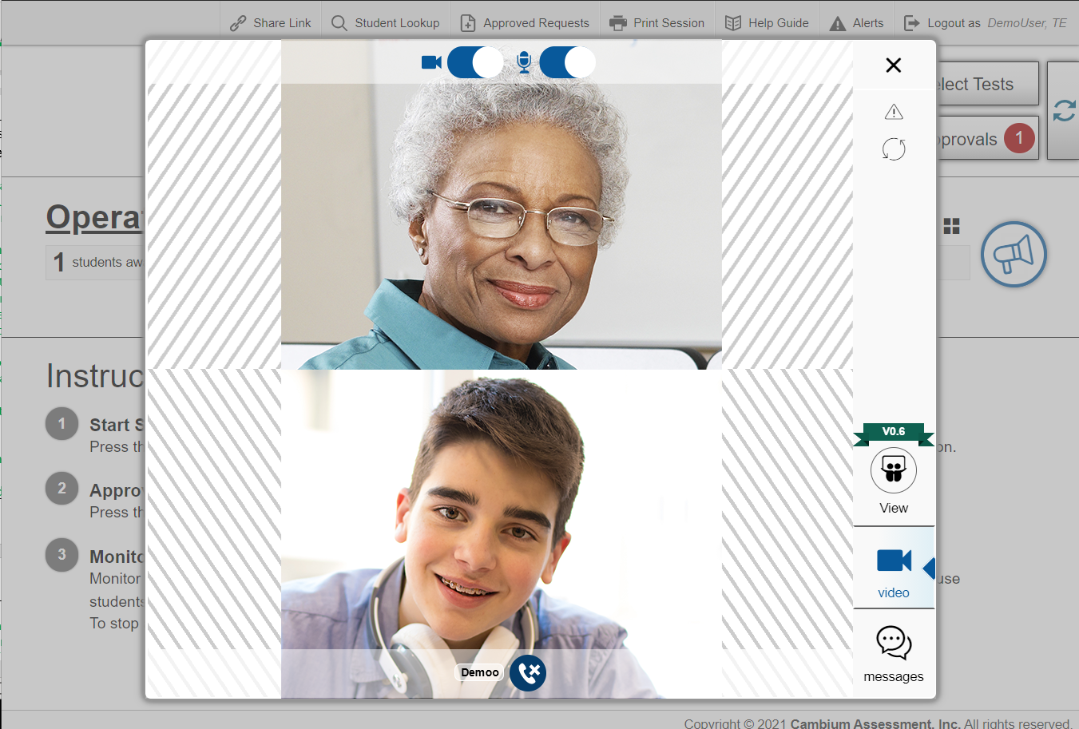
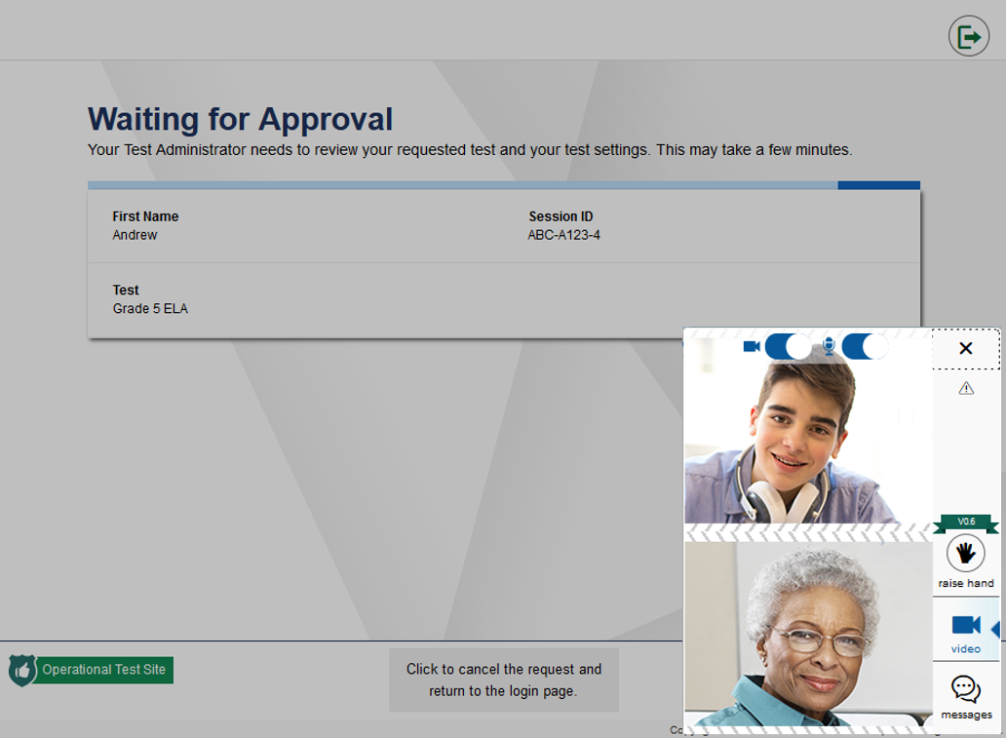
How to TAs and Students can Communicate via Video Conference
TA Screen
Student Screen
Notes:
The next way TAs and students can communicate during a remote test is via a one-to-one video conference.
To start a video conference with a student, select the student you want to video conference with to open the video conference window. A high-resolution feed from the student’s camera appears in the video conference window.
Select the phone icon at the bottom of the video window to call the student. The video window will appear on the student’s screen with a split-screen view of you and the student.
On the test administration site, you will also see the same split screen view of you and the student in the video window.

Slide 29
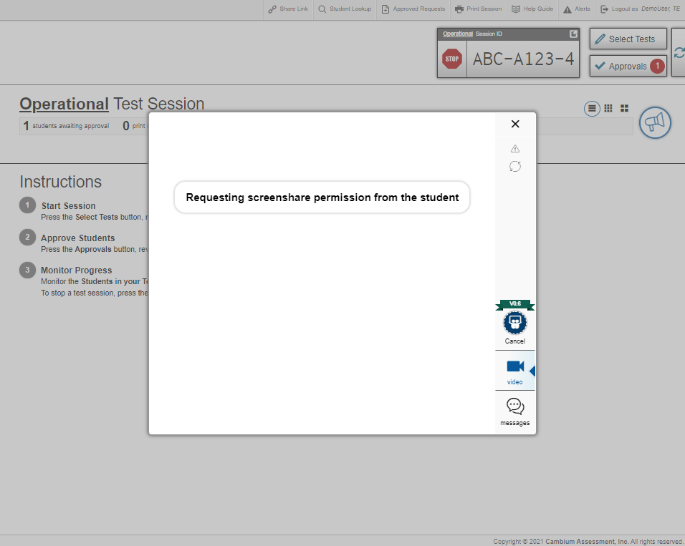
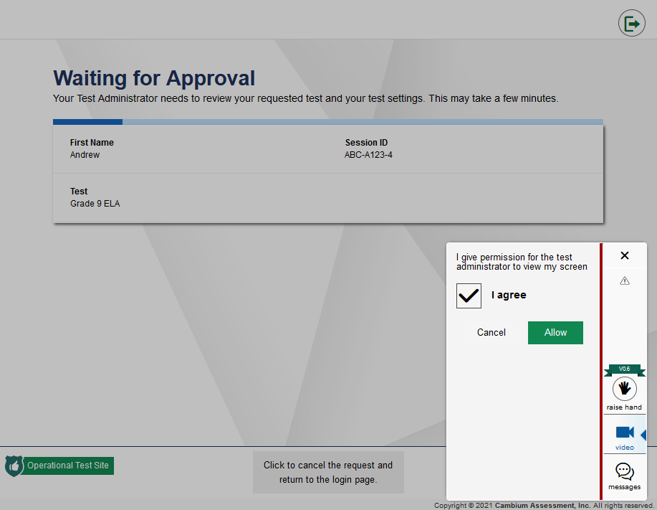
How to Observe a Student’s Screen using the Screenshare Feature
TA Screen
TA Screen
Notes:
Lastly, TAs and students can communicate by using the screenshare feature.
If you need to view a student’s screen, select the student video icon for that student. In the chat/video window that opens, select the View icon.
A message appears letting you know you have requested screenshare permission from the student.
The student will first need to give the TA permission to view their screen. To do so, the student will check the I Agree box. By checking the I Agree box, the student gives permission for the TA to view the student’s screen. Then the student will need to select Allow.
Once the student grants permission, a red dotted line will appear around the student’s screen indicating that their TA can now see their screen.
Do not take screenshots or screen captures of test items.

Slide 30
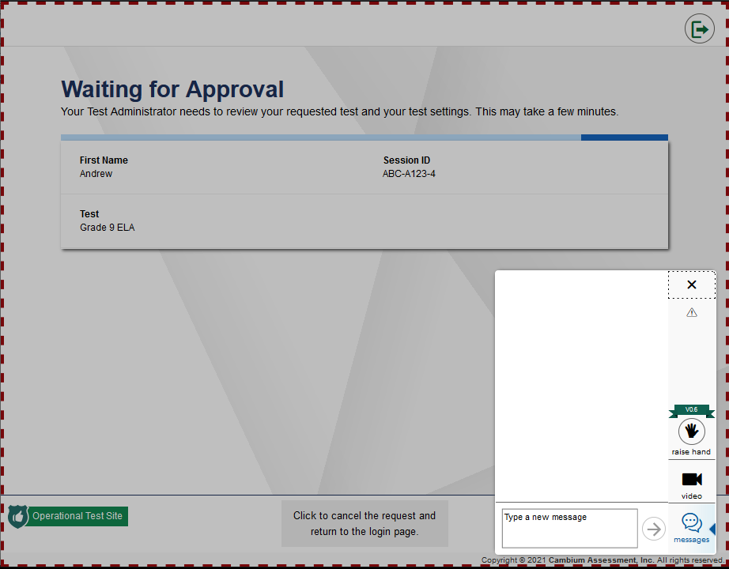
How to Observe a Student’s Screen using the Screenshare Feature
Student Screen
TA Screen
Notes:
Once the student grants permission, a red dotted line will appear around the student’s screen indicating that their TA can now see their screen.
On your computer, you will see a box with a live feed of the student’s screen.
When you are finished viewing the student’s screen, select the X in the upper right corner of the window.
The student will no longer see a red dotted line around their screen indicating that the TA can no longer see their screen.
Do not take screenshots or screen captures of test items.

Slide 31
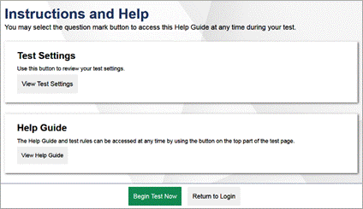
Completing the Approval Process so Students can Begin the Test
TA Screen
Student Screen
Notes:
Now let’s return to the Approvals and Student Test Settings window on the test administration site so that you can finish approving students to enter the test session.
To approve a student into the test session, select the green check mark in the row for that student. If you want to approve all students waiting for approval at once, select the Approve all Students button at the top of the pop-up window.
Once you approve a student into the test session, the student will see one final Instructions and Help screen before beginning their test. After students have reviewed this page, they will select Begin Test Now to see the first test question.

Slide 32
Viewing Students in Your Remote Test Session: Table View
Notes:
After approving students, you will see the Test Session table on the Test Administration Site. From this table, you can monitor student progress through the test, observe students, communicate with students, respond to test alerts, and pause or stop the test session.
While students are testing remotely, TAs can observe low resolution video of all remote students at once or select one remote student to view at high resolution. Low resolution video of all remote students appears automatically in the list of students on the test administration site.
By default, students in a test session appear listed in a table, as shown in the top image.

Slide 33
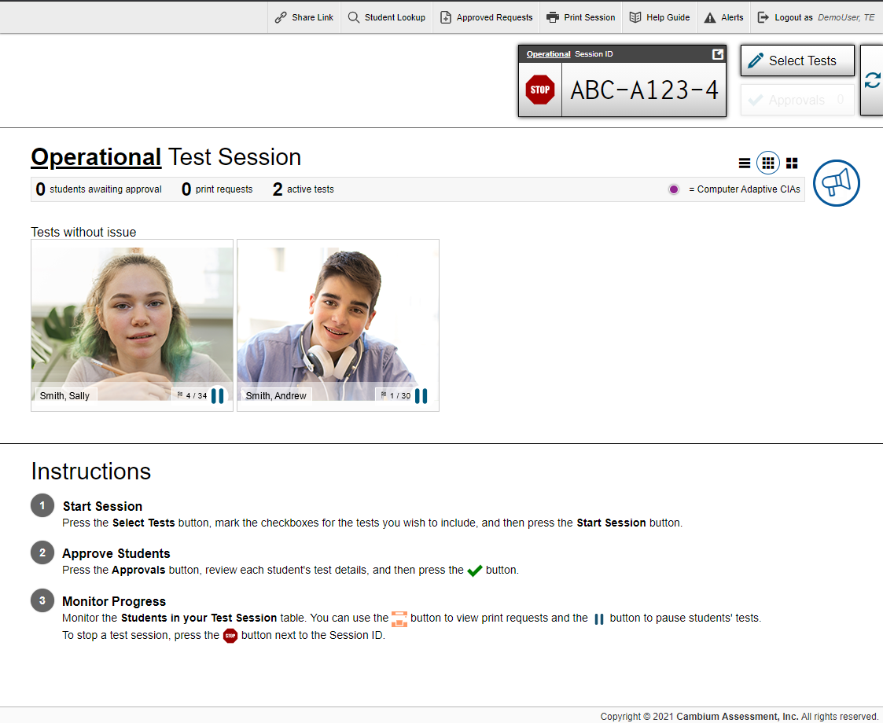
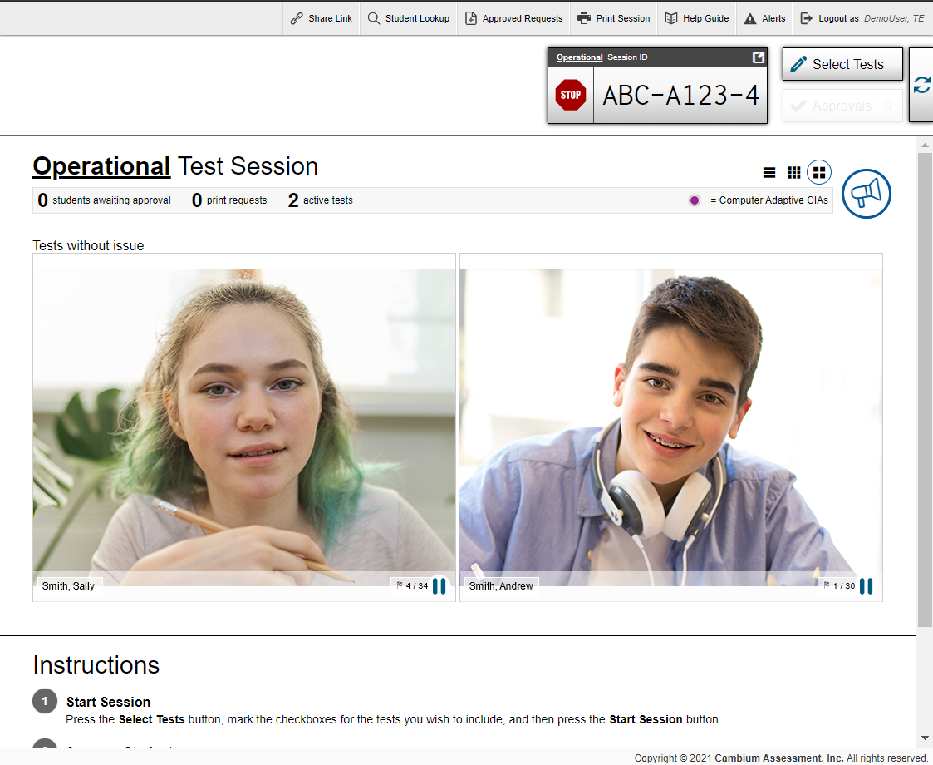
Viewing Students in Your Remote Test Session: Tile Views
3x3 Tile View
2x2 Tile View
Notes:
You can change to a small tile view of all students by selecting the 3x3 Tile View icon and can change to a large tile view of all students view by selecting the 2x2 Tile View icon. Both tile views will show low-resolution images of all students.

Slide 34
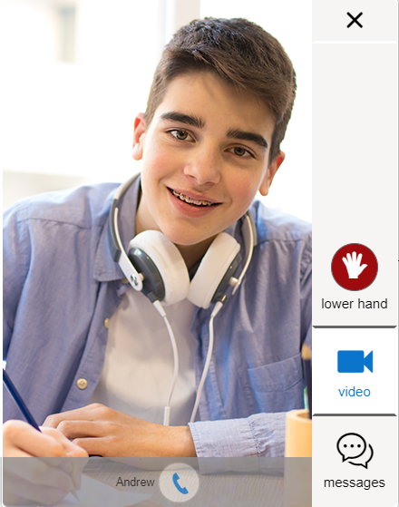
Observing Individual Students
Low-resolution of all students
High-resolution of one student
Notes:
TAs can observe low resolution video of all remote students at once or select one remote student to view at high resolution. Low resolution video of all remote students appears automatically in the list of students on the test administration site.
To view high resolution video of one remote student, select the student’s video icon next their name from the table of students in the test session from the test administration site. A window appears with a live view from the student’s webcam.
This is the same if you are viewing your students in tile view shown on the previous slide. Just select the student’s image from the grid of students.
When you are finished viewing the student, select the X button in the upper right corner to close the Video Conference pop-up window.

Slide 35
Responding to a Test Alert
Notes:
Test alerts for individual remote students may appear on the test administration site if the online testing system has not detected any activity from the remote student for some time.
This may happen if the remote student’s computer has gone to sleep or if the remote student is experiencing some interruption. In the event of a test alert, all remote student responses are saved, so remote students do not lose test data.
A TA may want to observe the remote student’s screen, observe the student through the student’s web camera, or start a one-to-one conference with the student.

Slide 36
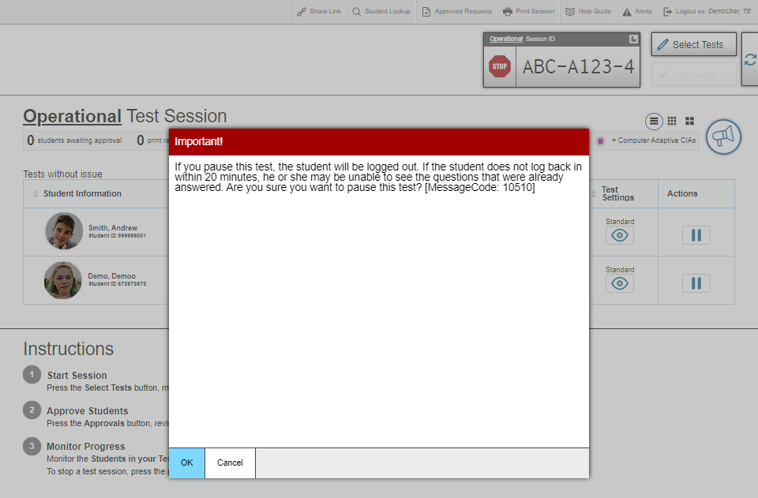
Pausing a Remote Session
Notes:
Just as with an in-person session in the classroom, TAs can pause a remote student’s test at any time by selecting the Pause button in the Actions column. If a remote student’s test is paused, the student will need to log back in. When the remote student resumes the test, the student will begin on the next unanswered item.
For all Hawaii summative assessments (except the Smarter Balanced ELA Performance Task and the HSA-Alt Assessments), it the remote test was paused for more than 20 minutes, the remote student will not be able to review previously completed questions, even if they had marked questions for review.

Slide 37
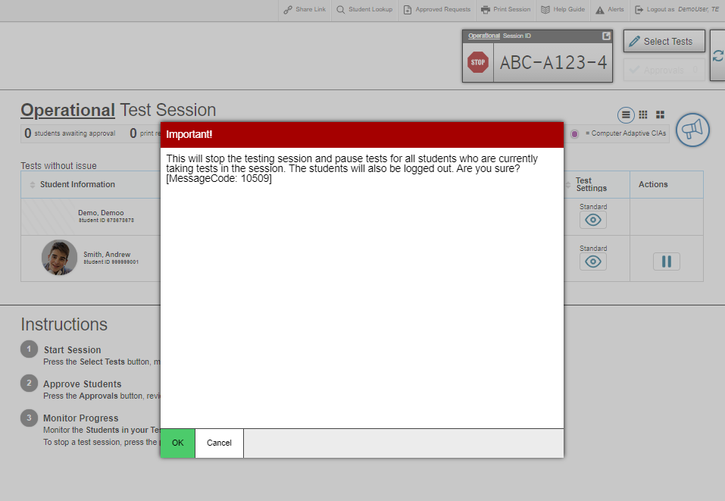
Stopping a Remote Session
Notes:
Just as with an in-person session in the classroom, TAs should end the remote test session once the last remote student testing submits their test. To stop a remote test session, the TA will need to select the stop sign button located next to the session ID in the upper-right corner of the test administration site.
Stopping a remote session automatically logs out all students in the remote session and pauses any incomplete tests. Once a remote test session is stopped, it cannot be resumed. If you want to resume remote testing, a new remote session will need to be started, and you will need to provide the new session ID to students.
Note that after the remote test session is stopped, the TA will no longer be able to see or communicate with students through the connection.
Once the test session in concluded, please close the WebEx session, navigate to the saved session, and upload to Caveon Core using the supplied instructions. Once the file has been successfully uploaded, please delete the file of the recording on your computer.

Slide 38
Thank You!
If you need additional information or have questions, please consult the Quick Guide for Test Administrators for Remote Summative Administration located on the AlohaHSAP.org portal: https://smarterbalanced.alohahsap.org/resources/resources-2022-2023/remote-summative-test-administration-2022-2023.
If you need further assistance, you call or email the HSAP Help Desk.
Hours: 7:30 a.m. to 4:00 p.m. HST, Monday – Friday (except holidays)
Phone: 1-866-648-3712
Email: HSAPHelpDesk@cambiumassessment.com
Notes:
Thank you for viewing this training module. If you need additional information or have questions, please consult the Quick Guide for Test Administrators for Remote Summative Administration located on the AlohaHSAP.org.
If you need further assistance, you call or email the HSAP Help Desk at 1-866-648-3712 or HSAPHelpDesk@cambiumassessment.com.

